Slide 1



Noida Institute of Engineering and Technology, Greater Noida
Set Theory, Relation, Function
UNIT-1
Discrete Structures
Ms. Garima Jain
Assistant Professor
CSET Department
B.Tech (DS)
IIIrd Sem

Slide 2
Content
Course Objective
Course Outcome
CO-PO Mapping
Syllabus
Prerequisite and Recap
Set Theory
Relation
Function
Combinatorics
Recurrence Relation & Generating Function
Proof Techniques

Slide 3
Content
Video links
Daily Quiz
Weekly Assignment
MCQ
Old Question papers
Expected Question for University Exam
Summary
References

Slide 4
Course Objective
The subject enhances one’s ability to develop logical thinking and ability to problem solving.
The objective of discrete structure is to enables students to formulate problems precisely, solve the problems, apply formal proofs techniques and explain their reasoning clearly.

Slide 5
Course Outcome
Course Outcome (CO) | At the end of course , the student will be able to | Bloom’s Knowledge Level (KL)
CO1 | Apply the basic principles of sets, relations & functions and mathematical induction in computer science & engineering related problems | K3
CO1 | Understand the algebraic structures and its properties to solve complex problems | K2
CO3 | Describe lattices and its types and apply Boolean algebra to simplify digital circuit. | K2,K3
CO4 | Infer the validity of statements and construct proofs using predicate logic formulas. | K3,K5
CO5 | Design and use the non-linear data structure like tree and graphs to solve real world problems. | K3,K6

Slide 6
Syllabus
UNIT-I Set Theory, Relation, Function
Set Theory: Introduction to Sets and Elements, Types of sets, Venn Diagrams, Set Operations, Multisets, Ordered pairs. Proofs of some general Identities on sets.
Relations: Definition, Operations on relations, Pictorial Representatives of Relations, Properties of relations, Composite Relations, Recursive definition of relation, Order of relations.
Functions: Definition, Classification of functions, Operations on functions, Growth of Functions. Combinatorics: Introduction, basic counting Techniques, Pigeonhole Principle.
Recurrence Relation & Generating function: Recursive definition of functions, Recursive Algorithms, Method of solving Recurrences.
Proof techniques: Mathematical Induction, Proof by Contradiction, Proof by Cases, Direct Proof
UNIT-II Algebraic Structures
Algebraic Structures: Definition, Operation, Groups, Subgroups and order, Cyclic Groups, Cosets, Lagrange's theorem, Normal Subgroups, Permutation and Symmetric Groups, Group Homomorphisms, Rings, Internal Domains, and Fields.

Slide 7
Syllabus
UNIT-III Lattices and Boolean Algebra
Ordered set, Posets, Hasse Diagram of partially ordered set, Lattices: Introduction, Isomorphic Ordered set, Well ordered set, Properties of Lattices, Bounded and Complemented Lattices, Distributive Lattices. Boolean Algebra: Introduction, Axioms and Theorems of Boolean Algebra, Algebraic Manipulation of Boolean Expressions, Simplification of Boolean Functions.
UNIT-IV Logics
Introduction, Propositions and Compound Statements, Basic Logical Operations, Wellformed formula, Truth Tables, Tautology, Satisfiability, Contradiction, Algebra of Proposition, Theory of Inference.

Slide 8
Syllabus
Predicate Logic: First order predicate, Well-formed formula of Predicate, Quantifiers, Inference Theory of Predicate Logic.
UNIT-V Tree and Graph
Trees: Definition, Binary tree, Complete and Extended Binary Trees, Binary Tree Traversal, Binary Search Tree.
Graphs: Definition and terminology, Representation of Graphs, Various types of Graphs, Connectivity, Isomorphism and Homeomorphism of Graphs, Euler and Hamiltonian Paths, Graph Coloring

Slide 9
Prerequisite & Recap
Prerequisite
Knowledge of Mathematics upto 12th standard.
Recap
The fundamental concepts of Sets, Relations and Functions, Logic, Probability and Boolean Algebra.

Slide 10
Topic Objectives: Set Theory (CO1)
The student will be able to:
Represent a set using set-builder notation.
Give examples of finite and infinite sets.
Build new sets from existing sets by applying various combinations of the set operations for example intersection union, difference, and complement.
Determine whether two sets are equal by determining whether each is a subset of the other
Sets are used to define the concepts of relations and functions. The study of geometry, sequences, probability, etc. requires the knowledge of sets.

Slide 11
Topic Prerequisite & Recap (CO1)
Prerequisite
Basic Understanding of mathematical objects and notions such as rational and real number fields.
Idea of surjective, injective and bijective functions.
Recap
Understanding of Boolean algebra axioms.

Slide 12
Introduction to Sets (CO1)
Set theory is important because it is a theory of integers, models of axiom systems, infinite ordinals, and real numbers, all in one unified structure.
The idea of set theory is to turn logical predications, like "x is less than 100 and x is greater than 1", into objects which can be manipulated by good formal rules. “Unordered collection” “distinct”
A set is defined as a collection of distinct objects of the same type or class of objects.
The purposes of a set are called elements or members of the set. An object can be numbers, alphabets, names, etc.
Examples of sets are:
A set of natural numbers.
A set of rivers of India.
A set of vowels in English alphabets. V={a,e,i,o,u}

Slide 13
Introduction to Sets (CO1)
We broadly denote a set by the capital letter A, B, C, etc. while the fundamentals of the set by small letter a, b, x, y, etc.
A is a set, and a is one of the elements of A
We denote it as a ∈ A.
Here the symbol ∈ means – “Belongs to” or “Element of”

Slide 14
Sets Representation (CO1)
Sets are represented in two forms:
Roster or tabular form: In this form of representation we list all the elements of the set within braces { } and separate them by commas.
Example:
If A = Set of all odd numbers less then 10, then A = { 1, 3, 5, 7, 9}.
If B = Set of vowel of English alphabets, then B = {‘a’, ‘e’, ‘i’, ‘o’, ‘u’ }.
Set Builder form: In this form of representation we list the properties fulfilled by all the elements of the set. We note as {x: x satisfies properties P}and read as 'the set of all x such that each x has properties P’.
Example:
If A = {1, 3, 5, 7, 9}, then A = {x : x=2n-1, where n ∈ N and n ≤ 5}
If B = {2, 4, 8, 16, 32, 64, 128}, then B={x : x=2^{n}, where n ∈ N and n < 8}

Slide 15
Standard Notations (CO1)
x ∈ A | x belongs to A or x is an element of set A.
x ∉ A | x does not belong to set A.
∅ or {} | Empty Set. Or Null Set
U | Universal Set.
N | The set of all natural numbers or {1, 2, 3, 4, 5, 6, 7, …}
I | The set of all integers or {…, -3, -2, -1, 0, 1, 2, 3,….}
I₀ | The set of all non- zero integers or {…,-3, -2, -1, 1, 2, 3, …}
I₊ | The set of all + ve integers or {1, 2, 3, 4, 5, …}
C, C₀ | The set of all complex, non-zero complex numbers respectively.
Q, Q₀, Q₊ | The sets of rational, non- zero rational, +ve rational numbers respectively.
R, R₀, R₊ | The set of real, non-zero real, +ve real number respectively.

Slide 16
Cardinality (CO1)
The total number of unique elements in the set is called the cardinality of the set.
If A is the set, then it is denoted as |A| , n (A), #A or card(A).
Examples:
Let P = {k, l, m, n} The cardinality of the set P is 4 i.e. n(P) = 4
Let A is the set of all non-negative even integers, i.e. A = {0, 2, 4, 6, 8, 10, ....}.
As A is countably infinite set and hence the cardinality.

Slide 17
Types of Sets (CO1)
Sets can be classified into many categories. Some of which are finite, infinite, subset, universal, proper, power, singleton set, etc.
Singleton Set: It contains only one element. It is denoted by {a}.
Example: S= {x | x ∈ N, 7 < x < 9} = {8}
Null Set or Empty Set: A set having no elements is called a Null set or void set. It is denoted by ∅ or {}.
Subsets: If every element in a set A is also an element of a set B, then A is called a subset of B. It can be denoted as A ⊆ B. Here B is called Superset of A. Example: If A= {1, 2} and B= {4, 2, 1} the A is the subset of B or A ⊆ B.
Every set is a subset of itself.
The Null Set i.e. ∅ is a subset of every set.
If A is a subset of B and B is a subset of C, then A will be the subset of C. If A⊂B and B⊂ C ⟹ A ⊂ C
A finite set having n elements has 2^{n} subsets.

Slide 18
Types of Sets (CO1)
Proper Subset: If A is a subset of B and A ≠ B then A is said to be a proper subset of B. If A is a proper subset of B then B is not a subset of A, i.e., there is at least one element in B which is not in A.
Example: A = {1, 2} and B = {1, 2, 3, 4}. A is proper subset of B.
The null ∅ is a proper subset of every non-void set.
Improper Subset: If A is a subset of B and A = B, then A is said to be an improper subset of B.
Example
A = {2, 3, 4}, B = {2, 3, 4} => A is an improper subset of B.
Every set is an improper subset of itself.

Slide 19
Types of Sets (CO1)
Infinite Sets: A set which is not finite is called as Infinite Sets.
It is of two types :
Countable Infinite: If there is one to one correspondence between the elements in set and element in N. A countably infinite set is also known as Denumerable. A set that is either finite or denumerable is known as countable. A set which is not countable is known as Uncountable. The set of a non-negative even integer is countable Infinite.
Uncountable Infinite: A set which is not countable is called Uncountable Infinite Set or non-denumerable set or simply Uncountable.
Example: Set R of all +ve real numbers less than 1 that can be represented by
the decimal form 0. a₁a₂a₃..... Where a₁ is an integer such that 0 ≤ a_{i} ≤ 9.

Slide 20
Types of Sets (CO1)
Equal Sets: Two sets A and B are said to be equal and written as A = B if both have the same elements. Therefore, every element which belongs to A is also an element of the set B and every element which belongs to the set B is also an element of the set A.
A = B ⟺ {x ϵ A ⟺ x ϵ B}.
If there is some element in set A that does not belong to set B or vice versa then
A ≠ B, i.e., A is not equal to B.
Equivalent Sets: If the cardinalities of two sets are equal, they are called equivalent sets.
Example: If A= {1, 2, 6} and B= {16, 17, 22}, they are equivalent as cardinality of
A is equal to the cardinality of B. i.e. |A|=|B|=3

Slide 21
Types of Sets (CO1)
Disjoint Sets: Two sets A and B are said to be disjoint if no element of A is in B and no element of B is in A.
Example:
R = {a, b, c}, S = {k, p, m}
R and S are disjoint sets.
Power Sets: The power of any given set A is the set of all subsets of A and is denoted by P (A). If A has n elements, then P (A) has 2^{n} elements.
Example: A = {1, 2, 3}
P (A) = {∅, {1}, {2}, {3}, {1, 2}, {1, 3}, {2, 3}, {1, 2, 3}}.

Slide 22
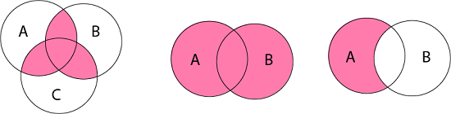
Venn Diagrams (CO1)
Venn diagram is a pictorial representation of sets in which an enclosed area in the plane represents sets.
Examples:

Slide 23
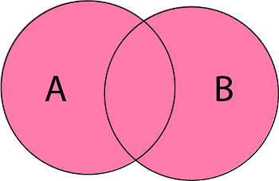
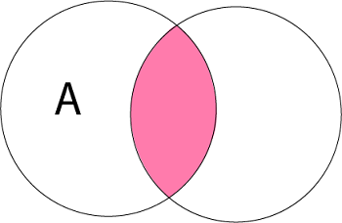
Operations on Sets (CO1)
The basic set operations are:
Union of Sets: Union of Sets A and B is defined to be the set of all those elements which belong to A or B or both and is denoted by A∪B.
A ∪ B = {x: x ∈ A or x ∈ B}
Example: Let A = {1, 2, 3}, B= {3, 4, 5, 6} A ∪ B = {1, 2, 3, 4, 5, 6}.
Intersection of Sets: Intersection of two sets A and B is the set of all those elements which belong to both A and B and is denoted by A ∩ B.
A ∩ B = {x: x ∈ A and x ∈ B}
Example: Let A = {11, 12, 13}, B = {13, 14, 15} A ∩ B = {13}.
B

Slide 24
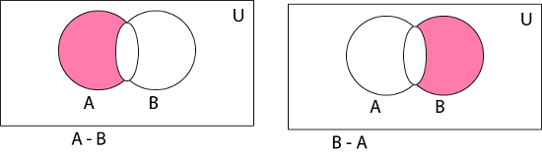
Operations on Sets (CO1)
Difference of Sets: The difference of two sets A and B is a set of all those elements which belongs to A but do not belong to B and is denoted by A - B.
A - B = {x: x ∈ A and x ∉ B}
Example: Let A= {1, 2, 3, 4} and B={3, 4, 5, 6} then A - B = {1, 2}
and B - A = {5, 6}

Slide 25

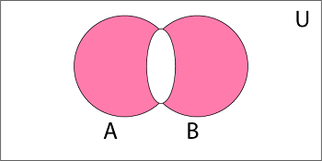
Operations on Sets (CO1)
Complement of a Set: The Complement of a Set A is a set of all those elements of the universal set which do not belong to A and is denoted by A^{c}.
A^{c} = U - A = {x: x ∈ U and x ∉ A} = {x: x ∉ A}
Example: Let U is the set of all natural numbers. A = {1, 2, 3} A^{c} = {all natural numbers except 1, 2, and 3}.
Symmetric Difference of Sets: The symmetric difference of two sets A and B is the set containing all the elements that are in A or B but not in both and is denoted by A ⨁ B i.e.
A ⨁ B = (A ∪ B) - (A ∩ B)
Example: Let A = {a, b, c, d} B = {a, b, l, m} A ⨁ B = {c, d, l, m}

Slide 26
Algebra of Sets (CO1)
1 | Idempotent Laws | (a) A ∪ A = A | (b) A ∩ A = A
2 | Associative Laws | (A ∪ B) ∪ C = A ∪ (B ∪ C) | (b) (A ∩ B) ∩ C = A ∩ (B ∩ C)
3 | Commutative Laws | (a) A ∪ B = B ∪ A | (b) A ∩ B = B ∩ A
4 | Distributive Laws | A ∪ (B ∩ C) = (A ∪ B) ∩ (A ∪ C) | (b) A ∩ (B ∪ C) = (A ∩ B) ∪ (A ∩ C)
5 | De Morgan's Laws | (a) (A ∪B)^{c}=A^{c}∩ B^{c} | (b) (A ∩B)^{c}=A^{c}∪ B^{c}
6 | Identity Laws | (a) A ∪ ∅ = A (b) A ∪ U = U | (c) A ∩ U =A (d) A ∩ ∅ = ∅
7 | Complement Laws | (a) A ∪ A^{c}= U (b) A ∩ A^{c}= ∅ | (c) U^{c}= ∅ (d) ∅^{c} = U
8 | Involution Law | (a) (A^{c})^{c} = A

Slide 27
Idempotent Law (CO1)
(a) A ∪ A = A
Solution:
Since, B ⊂ A ∪ B, therefore A ⊂ A ∪ A
Let x ∈ A ∪ A ⇒ x ∈ A or x ∈ A ⇒ x ∈ A
∴ A ∪ A ⊂ A
As A ∪ A ⊂ A and A ⊂ A ∪ A ⇒ A =A ∪ A. Hence Proved.
(b) A ∩ A = A
Solution:
Since, A ∩ B ⊂ B, therefore A ∩ A ⊂ A
Let x ∈ A ⇒ x ∈ A and x ∈ A ⇒ x ∈ A ∩ A
∴ A ⊂ A ∩ A
As A ∩ A ⊂ A and A ⊂ A ∩ A ⇒ A = A ∩ A. Hence Proved.

Slide 28
Associative Law (CO1)
(a) (A ∪ B) ∪ C = A ∪ (B ∪ C)
Solution:
Let some x ∈ (A ∪ B) ∪ C
⇒ (x ∈ A or x ∈ B) or x ∈ C
⇒ x ∈ A or x ∈ B or x ∈ C
⇒ x ∈ A or (x ∈ B or x ∈ C)
⇒ x ∈ A or x ∈ B ∪ C
⇒ x ∈ A ∪ (B ∪ C)
⇒ (A ∪ B) ∪ C ⊂ A ∪ (B ∪ C)………….(i)
Similarly, if some x ∈ A ∪ (B ∪ C),
then x ∈ (A ∪ B) ∪ C.
∴ A ∪ (B ∪ C) ⊂ (A ∪ B) ∪ C ………………….(ii)
From (i) and (ii), we have
(A ∪ B) ∪ C = A ∪ (B ∪ C) Hence Proved.

Slide 29
Associative Laws (CO1)
(b) (A ∩ B) ∩ C = A ∩ (B ∩ C)
Solution:
Let some x ∈ A ∩ (B ∩ C)
⇒ x ∈ A and x ∈ B ∩ C
⇒ x ∈ A and (x ∈ B and x ∈ C)
⇒ x ∈ A and x ∈ B and x ∈ C
⇒ (x ∈ A and x ∈ B) and x ∈ C)
⇒ x ∈ A ∩ B and x ∈ C
⇒ x ∈ (A ∩ B) ∩ C ⇒ A ∩ (B ∩ C) ⊂ (A ∩ B) ∩ C
Similarly, if some x ∈ A ∩ (B ∩ C),
then x ∈ (A ∩ B) ∩ C
⇒ (A ∩ B) ∩ C ⊂ A ∩ (B ∩ C)
⇒ (A ∩ B) ∩ C = A ∩ (B ∩ C)
Hence Proved.

Slide 30
Commutative Law (CO1)
(a) A ∪ B = B ∪ A
Solution:
To Prove A ∪ B = B ∪ A
A ∪ B = {x: x ∈ A or x ∈ B} = {x: x ∈ B or x ∈ A}
(∵ Order is not preserved in case of sets)
A ∪ B = B ∪ A.
Hence Proved.
(b) A ∩ B = B ∩ A
Solution:
To Prove A ∩ B = B ∩ A
A ∩ B = {x: x ∈ A and x ∈ B} = {x: x ∈ B and x ∈ A}
(∵ Order is not preserved in case of sets)
A ∩ B = B ∩ A.
Hence Proved.

Slide 31
Complement Laws (CO1)
(a) A ∪ A^{c}= U
Solution:
To Prove A ∪ A^{c}= U
Every set is a subset of U
∴ A ∪ A^{c} ⊂ U.................. (i)
We have to show that U ⊆ A ∪ A^{c}
Let x ∈ U
⇒ x ∈ A or x ∉ A
⇒ x ∈ A or x ∈ A^{c}
⇒ x ∈ A ∪ A^{c}
∴ U ⊆ A ∪ A^{c}................... (ii)
From (i) and (ii), we get A ∪ A^{c}= U. Hence Proved.
(b) ∅^{c} = U
Solution:
Let x ∈ ∅^{c} ⇒ x ∉ ∅ ⇒ x ∈ U ⇒ ∅^{c} ⊆ U……….(i)
Now, Let y ∈ U ⇒ y ∉ ∅ ⇒ y ∈ ∅^{c} ……….(ii)
From (i) and (ii), we have ∅^{c} = U. Hence Proved.

Slide 32
Complement Laws (CO1)
(c) U^{c}= ∅
Solution:
Let x ∈ U^{c} ⇒ x ∉ U ⇒ x ∈ ∅ ⇒ U^{c} ⊆ ∅ ………(i)
Now, Let x ∈ ∅ ⇒ x ∉ U ⇒ x ∈ U^{c} ⇒ ∅ ⊆ U^{c}............(ii)
From (i) and (ii), we have
∴ U^{c}= ∅. Hence Proved.
(d) A ∩ A^{c}=∅
Solution:
As ∅ is the subset of every set
∴ ∅ ⊆ A ∩ A^{c}..................... (i)
We have to show that A ∩ A^{c} ⊆ ∅
Let x ∈ A ∩ A^{c}
⇒ x ∈ A and x ∈ A^{c}
⇒ x ∈ A and x ∉ A ⇒ x ∈ ∅ ∴ A ∩ A^{c} ⊂∅..................... (ii)
From (i) and (ii), we get A∩ A^{c}=∅.
Hence Proved.

Slide 33
Involution Law (CO1)
(a) (A^{c})^{c} =A.
Solution:
Let x ∈ (A^{c})^{c}
⇒ x ∉ A^{c}
⇒ x ∈ A
⇒ (A^{c} )^{c} ⊆ A ………….(i)
Now, let y ∈ A
⇒ y ∉ A^{c}
⇒ y ∈ (A^{c})^{c} ⇒ A ⊆ (A^{c})^{c} ………….(ii)
From (i) and (ii), we have
∴ (A^{c} )^{c} =A.
Hence Proved.

Slide 34
Duality (CO1)
The dual E∗ of E is the equation obtained by replacing every occurrence of ∪, ∩, U and ∅ in E by ∩, ∪, ∅, and U, respectively. For example, the dual of
(U ∩ A) ∪ (B ∩ A) = A is (∅ ∪ A) ∩ (B ∪ A) = A
It is noted as the principle of duality, that if any equation E is an identity, then its dual E∗ is also an identity.

Slide 35
Principle of Extension (CO1)
According to the Principle of Extension two sets, A and B are the same if and only if they have the same members. We denote equal sets by A=B.
If A= {1, 3, 5} and B= {3, 1, 5}, then A=B i.e., A and B are equal sets.
If A= {1, 4, 7} and B= {5, 4, 8}, then A≠ B i.e.., A and B are unequal sets.

Slide 36
Multisets (CO1)
A multiset is an unordered collection of elements, in which the multiplicity of an element may be one, more than one or zero.
The multiplicity of an element is the number of times the element repeated in the multiset.
In other words, we can say that an element can appear any number of times in a set.
Example:
A = {l, l, m, m, n, n, n, n}
B = {a, a, a, a, a, c}

Slide 37
Operations on Multisets (CO1)
Union of Multisets: The Union of two multisets A and B is a multiset such that the multiplicity of an element is equal to the maximum of the multiplicity of an element in A and B and is denoted by A ∪ B.
Example:
Let A = {l, l, m, m, n, n , n, n}
B = {l, m, m, m, n},
A ∪ B = {l, l, m, m, m, n, n, n, n}
Intersections of Multisets: The intersection of two multisets A and B, is a multiset such that the multiplicity of an element is equal to the minimum of the multiplicity of an element in A and B and is denoted by A ∩ B.
Example:
Let A = {l, l, m, n, p, q, q, r}
B = {l, m, m, p, q, r, r, r, r}
A ∩ B = {l, m, p, q, r}.

Slide 38
Operations on Multisets (CO1)
Difference of Multisets: The difference of two multisets A and B, is a multiset such that the multiplicity of an element is equal to the multiplicity of the element in A minus the multiplicity of the element in B.
Example:
Let A = {l, m, m, m, n, n, n, p, p, p}
B = {l, m, m, m, n, r, r, r}
A - B = {n, n, p, p, p}

Slide 39
Ordered Set & Ordered Pairs (CO1)
Ordered Set:
It is defined as the ordered collection of distinct objects.
Example:
Roll no {3, 6, 7, 8, 9}
Week Days {Sun, Mon, Tue, Wed, Thu, Fri, Sat}

Slide 40

Cartesian product of two sets (CO1)
The Cartesian Product of two sets P and Q in that order is the set of all ordered pairs whose first member belongs to the set P and second member belong to set Q and is denoted by P x Q, i.e.,
P x Q = {(x, y): x ∈ P, y ∈ Q}
n(P x Q) =n(P) x n(Q)
Example: Let P = {a, b, c} and Q = {k, l, m, n}. Determine the Cartesian product of P and Q.
Solution: The Cartesian product of P and Q is

Slide 41
Cartesian product of two sets (CO1)
Let A ={a, b} and B = {1, 2}
A x B = {(a, 1), (a, 2), (b, 1), (b, 2)}
Power set of A x B
P(A x B) =
{
∅, {(a, 1)}, {(a, 2)}, {(b, 1)}, {(b, 2)},
{(a, 1), (a, 2)}, {(a, 1), (b, 1)}, {(a, 1), (b, 2)}, {(a, 2), (b, 1)}, {(a, 2), (b, 2)}, {(b, 1), (b, 2)},
{(a, 1), (a, 2), (b, 1)}, {(a, 1), (a, 2), (b, 2)}, {(a, 1), (b, 1), (b, 2)}, {(a, 2), (b, 1), (b, 2)}
{(a, 1), (a, 2), (b, 1), (b, 2)}
}
Cardinality of P(A x B) = n(P(A x B))= 2^{n(A) x n(B)} = 2^{2 x 2} = 2⁴ = 16

Slide 42
Topic Objective: Relation (CO1)
To introduce relations, and will show their connection to sets, and their use in DBMS.
To find out the relationship between the elements of set using relations.

Slide 43
Topic Prerequisite & Recap (CO1)
Prerequisite
Basic Understanding of Set Theory.
Recap
To develop the logical thinking by using Sets concepts and their use in upcoming topic. i.e. Relations.

Slide 44
Binary Relation (CO1)
Whenever sets are being discussed, the relationship between the elements of the sets is the next thing that comes up.
Relations may exist between objects of the same set or between objects of two or more sets.
Let P and Q be two non- empty sets.
A binary relation R is defined to be a subset of P x Q i.e. R ⊆ P x Q.
If (a, b) ∈ R and R ⊆ P x Q then a is related to b by R i.e., aRb.
If sets P and Q are equal, then we say R ⊆ P x P is a relation on P.

Slide 45
Binary Relation (CO1)
(i) Let A = {a, b, c} and B = {r, s, t}
Then R = {(a, r), (b, r), (b, t), (c, s)} is a relation from A to B.
(ii) Let A = {1, 2, 3} and B = A
Then R = {(1, 1), (2, 2), (3, 3)} is a relation (equal) on A.

Slide 46
Binary Relation (CO1)
Example : If a set A = {1, 2}. Determine all relations from A to A.
Solution: There are 2²= 4 elements i.e., {(1, 1), (1, 2), (2, 1), (2, 2)} in A x A. So, there are 2⁴= 16 relations from A to A. i.e.
∅,
{(1, 1)}, {(1, 2)}, {(2, 1)},{(2, 2)} ,
{(1, 1), (1, 2)}, {(1, 1), (2, 1)}, {(1, 1), (2, 2)},
{(1, 2), (2, 1)}, {(1, 2), (2, 2)}, {(2, 1), (2, 2)}, {(1, 1), (1, 2), (2, 1)}, {(1, 1), (1, 2), (2, 2)},
{(1, 1), (2, 1), (2, 2)}, {(1, 2), (2, 1), (2, 2)},
{(1, 1), (1, 2), (2, 1), (2, 2)}.

Slide 47
Domain and Range of Relation (CO1)
Domain of Relation: The Domain of relation R is the set of elements in P which are related to some elements in Q, or it is the set of all first entries of the ordered pairs in R. It is denoted by DOM (R).
Range of Relation: The range of relation R is the set of elements in Q which are related to some element in P, or it is the set of all second entries of the ordered pairs in R. It is denoted by RAN (R).
Example:
Let A = {1, 2, 3, 4}
B = {a, b, c, d}
R = {(1, a), (1, b), (1, c), (2, b), (2, c), (2, d)}.
Solution:
DOM (R) = {1, 2}
RAN (R) = {a, b, c, d}

Slide 48
Complement of a Relation (CO1)
Consider a relation R from a set A to set B. The complement of relation R denoted by R^{c} is a relation from A to B such that
R^{c} = {(a, b): (a, b) ∈ A x B and (a, b) ∉ R}.
Example: Consider the relation R from X to Y
X = {1, 2, 3}
Y = {8, 9}
R = {(1, 8), (2, 8), (1, 9), (3, 9)}
Find the complement relation of R.
Solution:
X x Y = {(1, 8), (2, 8), (3, 8), (1, 9), (2, 9), (3, 9)}
Now we find the complement relation R from X x Y
R^{c} = {(3, 8), (2, 9)}

Slide 49
Inverse of a Relation (CO1)
Consider a relation R from a set A to set B i.e. R ⊆ A x B. The inverse of relation R denoted by R⁻¹ is a relation from B to A i.e. R⁻¹ ⊆ B x A such that
R⁻¹ = {(b, a): (a, b) ∈ R}.
Example:
Consider the relation R from X to Y
X = {1, 2, 3}
Y = {8, 9}
R = {(1, 8), (2, 8), (1, 9), (3, 9)}
Find the inverse relation of R.
Solution:
R⁻¹ = {(8, 1), (8, 2), (9, 1), (9, 3)}

Slide 50
Operations of a Relations (CO1)
Let A ={1, 2, 3} and B={1, 2, 3, 4}. The relations R1 and R2 from A to B are given as
R1 = {(1, 1), (2, 2), (3, 3)} and R2 = {(1, 1), (1, 2), (1, 3), (1, 4)}
Therefore
R1 ∪ R2 = {(1, 1), (1, 2), (1, 3), (1, 4), (2, 2), (3, 3)}
R1 ∩ R2 = {(1, 1)}
R1 – R2 = {(2, 2), (3, 3)}
R2 – R1= {(1, 2), (1, 3), (1, 4)}

Slide 51
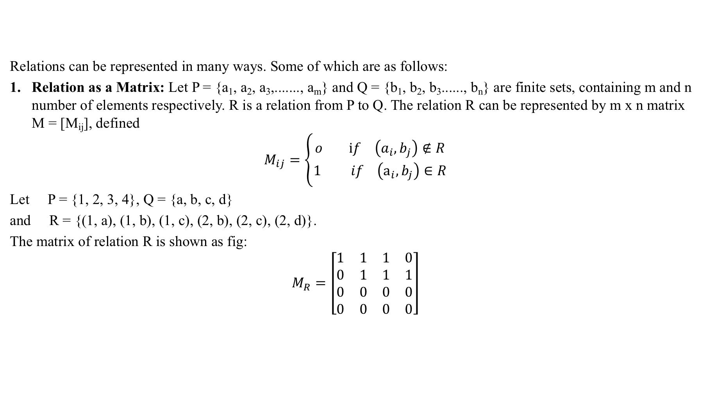
Representation of Relations (CO1)

Slide 52
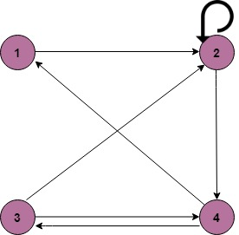
Representation of Relations (CO1)
2. Relation as a Directed Graph: There is another way of picturing a relation R when R is a relation from a finite set to itself.
Example:
A = {1, 2, 3, 4}
R = {(1, 2) (2, 2) (2, 4) (3, 2) (3, 4) (4, 1) (4, 3)}

Slide 53
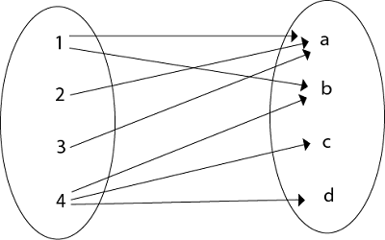
Representation of Relations (CO1)
3. Relation as an Arrow Diagram: If P and Q are finite sets and R is a relation from P to Q. Relation R can be represented as an arrow diagram as follows.
Example:
Let P = {1, 2, 3, 4}
Q = {a, b, c, d}
R = {(1, a), (1, b), (2, a), (3, a), (4, b), (4, c), (4, d)
The arrow diagram of relation R is shown in fig:

Slide 54
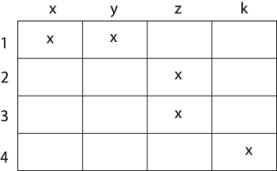
Representation of Relations (CO1)
4. Relation as a Table: If P and Q are finite sets and R is a relation from P to Q. Relation R can be represented in tabular form.
Example
Let P = {1, 2, 3, 4}
Q = {x, y, z, k}
R = {(1, x), (1, y), (2, z), (3, z), (4, k)}.
The tabular form of relation as shown in fig:

Slide 55
Composition of Relations (CO1)
Let A, B, and C be sets, and let R be a relation from A to B and let S be a relation from B to C. That is, R is a subset of A × B i.e. R ⊆ A × B and S is a subset of B × C i.e. S ⊆ B × C. Then R and S give rise to a relation from A to C indicated by R◦S and defined by:
a (R◦S)c if for some b ∈ B we have aRb and bSc.
i.e. ,
R ◦ S = {(a, c)| there exists b ∈ B for which (a, b) ∈ R and (b, c) ∈ S}
The relation R◦S is known the composition of R and S; it is sometimes denoted simply by RS.
Let R is a relation on a set A, that is, R is a relation from a set A to itself. Then R◦R, the composition of R with itself. Also, R◦R is sometimes denoted by R². Similarly, R³ = R²◦R = R◦R◦R, and so on. Thus R^{n} is defined for all positive n.

Slide 56
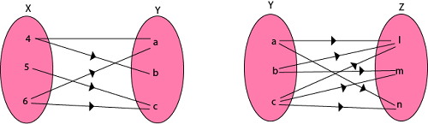
Composition of Relations (CO1)
Example1: Let X = {4, 5, 6}, Y = {a, b, c} and Z = {l, m, n}. Consider the relation R₁ from X to Y and R₂ from Y to Z.
R₁ = {(4, a), (4, b), (5, c), (6, a), (6, c)}
R₂ = {(a, l), (a, n), (b, l), (b, m), (c, l), (c, m), (c, n)}
Find the composition of relation (i) R₁ o R₂ (ii) R₁o R₁⁻¹

Slide 57
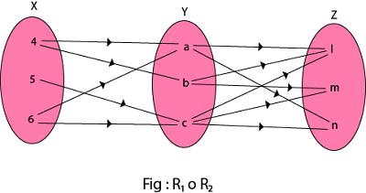
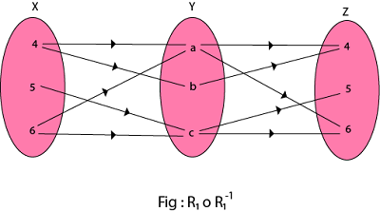
Composition of Relations (CO1)
Solution:
(i) The composition relation R₁ o R₂ as shown in fig:
R₁ o R₂ ={(4, l), (4, n), (4, m), (5, l), (5, m), (5, n), (6, l), (6, m), (6, n)}
(ii) The composition relation R₁o R₁⁻¹ as shown in fig:
R₁o R₁⁻¹ = {(4, 4), (5, 5), (5, 6), (6, 4), (6, 5), (4, 6), (6, 6)}
X

Slide 58
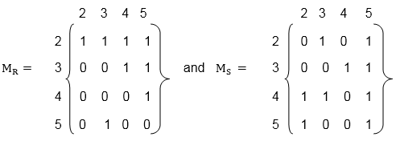
Composition of Relations and Matrices (CO1)
There is another way of finding R◦S. Let M_{R} and M_{S} denote respectively the matrix representations of the relations R and S. Then
Example:
Let A = {2, 3, 4, 5}. Consider the relation R and S on A defined by
R = {(2, 2), (2, 3), (2, 4), (2, 5), (3, 4), (3, 5), (4, 5), (5, 3)}
S = {(2, 3), (2, 5), (3, 4), (3, 5), (4, 2), (4, 3), (4, 5), (5, 2), (5, 5)}.
Find the matrices of the above relations. Use matrices to find the following composition of the relation R and S.
(i) RoS (ii) RoR (iii) SoR

Slide 59
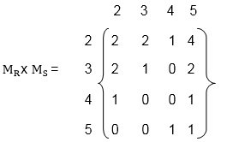
Composition of Relations and Matrices (CO1)
(i) To obtain the composition of relation R and S. First multiply M_{R} with M_{S} to obtain the matrix M_{R} x M_{S} as shown in fig:
The non zero entries in the matrix M_{R} x M_{S} tells the elements related in RoS. So,
Hence the composition R o S of the relation R and S is
R o S = {(2, 2), (2, 3), (2, 4), (2, 5), (3, 2), (3, 3), (3, 5), (4, 2), (4, 5), (5, 4), (5, 5)}.

Slide 60
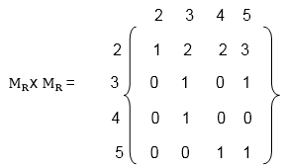
Composition of Relations and Matrices (CO1)
(ii) First, multiply the matrix M_{R} by itself, as shown in fig
Hence the composition R o R of the relation R and S is
R o R = {(2, 2), (3, 2), (3, 3), (3, 4), (4, 2), (4, 5), (5, 2), (5, 3), (5, 5)}

Slide 61
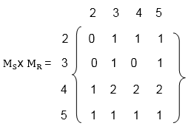
Composition of Relations and Matrices (CO1)
(iii) Multiply the matrix M_{S} with M_{R} to obtain the matrix M_{S} x M_{R} as shown in fig:
The non-zero entries in matrix M_{S} x M_{R} tells the elements related in SoR.
Hence the composition S o R of the relation S and R is
S o R = {(2, 4) , (2, 5), (3, 3), (3, 4), (3, 5), (4, 2), (4, 4), (4, 5), (5, 2), (5, 3), (5, 4), (5, 5)}.

Slide 62
Types of Relations (CO1)
Reflexive Relation:
A relation R on set A is said to be a reflexive if (a, a) ∈ R for every a ∈ A.
Example:
If A = {1, 2, 3, 4} then R = {(1, 1) (2, 2), (1, 3), (2, 4), (3, 3), (3, 4), (4, 4)}. Is a relation reflexive?
Solution:
The relation is reflexive as for every a ∈ A implies (a, a) ∈ R,
i.e. (1, 1), (2, 2), (3, 3), (4, 4) ∈ R.

Slide 63
Types of Relations (CO1)
Irreflexive Relation:
A relation R on set A is said to be irreflexive if (a, a) ∉ R for every a ∈ A.
Example:
Let A = {1, 2, 3} and R = {(1, 2), (2, 2), (3, 1), (1, 3)}. Is the relation R reflexive or irreflexive?
Solution:
The relation R is not reflexive as for every a ∈ A implies (a, a) ∉ R, i.e., (1, 1) and (3, 3) ∉ R.
The relation R is not irreflexive as (a, a) ∉ R, for some a ∈ A, i.e., (2, 2) ∈ R.

Slide 64
Types of Relations (CO1)
Symmetric Relation: A relation R on set A is said to be symmetric
iff (a, b) ∈ R ⟺ (b, a) ∈ R for all a, b ∈ R
Relation ⊥ is symmetric since a line a is ⊥ to b, then b is ⊥ to a.
Also, Parallel is symmetric, since if a line a is ∥ to b then b is also ∥ to a.
Example: Let A = {1, 2, 3} and R = {(1, 1), (2, 2), (1, 2), (2, 1), (2, 3), (3, 2)}. Is a relation R symmetric or not?
Solution: The relation is symmetric as for every (a, b) ∈ R, we have (b, a) ∈ R, i.e., (1, 2), (2, 1), (2, 3), (3, 2) ∈ R but not reflexive because (3, 3) ∉ R.

Slide 65
Types of Relations (CO1)
4. Antisymmetric Relation: A relation R on a set A is antisymmetric iff (a, b) ∈ R and (b, a) ∈ R then a = b.
Example: Let A = {1, 2, 3} and R = {(1, 1), (2, 2)}. Is the relation R antisymmetric?
Solution: The relation R is antisymmetric as a = b when (a, b) and (b, a) both belong to R.

Slide 66
Types of Relations (CO1)
5. Asymmetric Relation: A relation R on a set A is called an Asymmetric Relation if for every (a, b) ∈ R implies that (b, a) does not belong to R.
6. Transitive Relations: A Relation R on set A is said to be transitive iff (a, b) ∈ R and (b, c) ∈ R ⇒ (a, c) ∈ R for a, b, c ∈ R
Example1: Let A = {1, 2, 3} and R = {(1, 2), (2, 1), (1, 1), (2, 2)}. Is the relation transitive?
Solution: The relation R is transitive as for every (a, b), (b, c) belong to R, we have (a, c) ∈ R i.e, (1, 2) (2, 1) ∈ R ⇒ (1, 1) ∈ R.

Slide 67
Types of Relations (CO1)
7. Identity Relation: Identity relation I_{A} on set A is defined as
I_{A} = {(a, a) | a ∈ A }
Example: A= {1, 2, 3} = {(1, 1), (2, 2), (3, 3)}
8. Void Relation: It is given by R: A →B such that R = ∅ (⊆ A x B) is a null relation. Void Relation R = ∅ is symmetric and transitive but not reflexive.
9. Universal Relation: A relation R: A →B such that R = A x B (⊆ A x B) is a universal relation. Universal Relation from A →B is reflexive, symmetric and transitive. So this is an equivalence relation.

Slide 68
Closure Properties of Relations (CO1)
Consider a given set A, and the collection of all relations on A. Let P be a property of such relations, such as being symmetric or being transitive. A relation with property P will be called a P-relation. The P-closure of an arbitrary relation R on A, indicated P (R), is a P-relation such that
R ⊆ P (R) ⊆ S
(1) Reflexive and Symmetric Closures: The next theorem tells us how to obtain the reflexive and symmetric closures of a relation easily.
Theorem: Let R be a relation on a set A. Then:
R ∪ ∆_{A} is the reflexive closure of R
R ∪ R⁻¹ is the symmetric closure of R.

Slide 69
Closure Properties of Relations (CO1)
Example1: Let A = {k, l, m}. Let R is a relation on A defined by
R = {(k, k), (k, l), (l, m), (m, k)}.
Find the reflexive closure of R.
Solution: R ∪ ∆ is the smallest relation having reflexive property,
Hence, R_{F} = R ∪ ∆ = {(k, k), (k, l), (l, l), (l, m), (m, m), (m, k)}.
Example2: Consider the relation R on A = {4, 5, 6, 7} defined by
R = {(4, 5), (5, 5), (5, 6), (6, 7), (7, 4), (7, 7)}
Find the symmetric closure of R.
Solution: The smallest relation containing R having the symmetric property is R ∪ R⁻¹,i.e.
R_{S} = R ∪ R⁻¹ = {(4, 5), (5, 4), (5, 5), (5, 6), (6, 5), (6, 7), (7, 6), (7, 4), (4, 7), (7, 7)}.

Slide 70
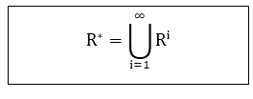
Closure Properties of Relations (CO1)
(2)Transitive Closures: Consider a relation R on a set A. The transitive closure R of a relation R of a relation R is the smallest transitive relation containing R.
Recall that R² = R◦ R and R^{n} = R^{n-1} ◦ R. We define
The following Theorem applies:
Theorem1: R* is the transitive closure of R
Suppose A is a finite set with n elements. Then R* = R ∪R² ∪.....∪ R^{n}
Theorem 2: Let R be a relation on a set A with n elements. Then
Transitive (R) = R ∪ R²∪.....∪ R^{n}

Slide 71
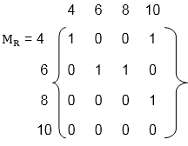
Closure Properties of Relations (CO1)
Example1: Consider the relation R = {(1, 2), (2, 3), (3, 3)} on A = {1, 2, 3}. Then R² = R◦ R = {(1, 3), (2, 3), (3, 3)} and R³ = R² ◦ R = {(1, 3), (2, 3), (3, 3)} Accordingly, Transitive (R) = {(1, 2), (2, 3), (3, 3), (1, 3)}
Example2: Let A = {4, 6, 8, 10} and R = {(4, 4), (4, 10), (6, 6), (6, 8),
(8, 10)} is a relation on set A. Determine transitive closure of R.
Solution: The matrix of relation R is shown in fig:

Slide 72
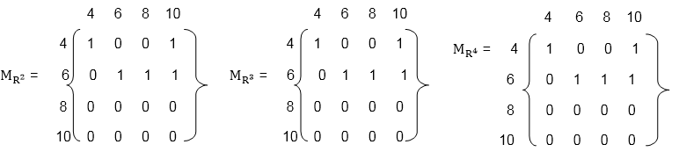
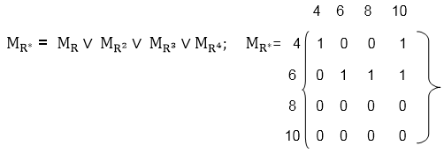
Closure Properties of Relations (CO1)
Now, find the powers of M_{R} as in fig:
Hence, the transitive closure of M_{R} is M_{R}* as shown in Fig (where M_{R}* is the ORing of a power of M_{R})
Thus, R* = {(4, 4), (4, 10), (6, 8), (6, 6), (6, 10), (8, 10)}

Slide 73
Equivalence Relation (CO1)
Consider the set of every person in the world
Now consider a R relation such that (a,b)∈R if a and b are siblings.
Clearly this relation is
Reflexive
Symmetric, and
Transitive
Such as relation is called an equivalence relation.
Definition: A relation on a set A is an equivalence relation if it is reflexive, symmetric, and transitive
Example: Let R={ (a,b) | a,b∈R and a≤b}
Is R reflexive?
Is it transitive?
Is it symmetric?
No, it is not. 4 is related to 5 (4 ≤ 5) but 5 is not related to 4
Thus R is not an equivalence relation

Slide 74
Topic Objective: Function (CO1)
The student will be able to:
use the composition of logarithms and the floor or ceiling functions to solve problems.
give complete or partial arrow diagrams for iterated functions.
use algebraic methods to locate all cycles of length 1 and length 2 for given functions.
use the principle of mathematical induction to prove that a given sequence eventually reaches one of several cycles.

Slide 75
Topic Prerequisite & Recap (CO1)
Prerequisite
Basic Understanding of Set Theory & Relations.
Recap
To develop the logical thinking by using Sets and Relations concepts and use in upcoming topic. i.e. Functions.

Slide 76
Functions (CO1)
A Function assigns to each element of a set, exactly one element of a related set. Functions find their application in various fields like representation of the computational complexity of algorithms, counting objects, study of sequences and strings, to name a few.
It is a mapping in which every element of set A is uniquely associated at the element with set B. The set of A is called Domain of a function and set of B is called Co domain.
Domain of a Function: Let f be a function from P to Q.
The set P is called the domain of the function f.
Co-Domain of a Function: Let f be a function from P to Q.
The set Q is called Co-domain of the function f.

Slide 77
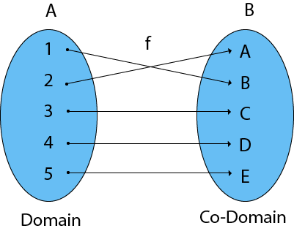
Functions (CO1)
Range of a Function: The range of a function is the set of picture of its domain. In other words, we can say it is a subset of its co-domain. It is denoted as f (domain).
If f: P → Q, then f (P) = {f(x): x ∈ P} = {y: y ∈ Q | ∃ x ∈ P, such that f (x) = y}.

Slide 78
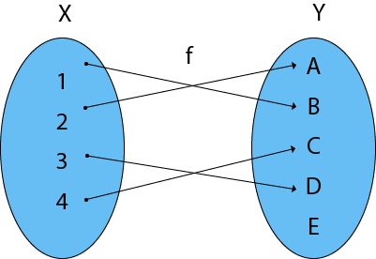
Example (CO1)
Example: Find the Domain, Co-Domain, and Range of function.
Let x = {1, 2, 3, 4}
y = {a, b, c, d, e}
f = {(1, b), (2, a), (3, d), (4, c)
Solution:
Domain of function: {1, 2, 3, 4}
Range of function: {a, b, c, d}
Co-Domain of function: {a, b, c, d, e}

Slide 79
Function mapping (CO1)
Definition: A function f from set A to set B, denoted f: A→B, is an assignment of each element of A to exactly one element of B.
We write f(a) = b if b is the unique element of B assigned to the element a of A.
Students
Grades
Functions are also called mappings
A
Jay
B
Vijay
C
Ajay
D
F
Sanjay

Slide 80
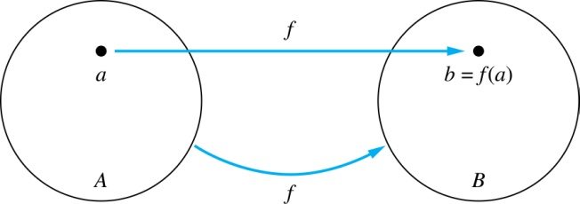
Function mapping (CO1)
Given a function f: A → B
A is called the domain of f
B is called the codomain of f
f is a mapping from A to B
If f(a) = b
then b is called the image of a under f
a is called the preimage of b
The range (or image) of f is the set of all images of points in A. We denote it by f(A).

Slide 81
Function mapping (CO1)
The domain of f is A
The codomain of f is B
The image of b is y
f(b) = y
The preimage of y is b
The preimage of z is {a,c,d}
The range/image of A is {y,z}
f(A) = {y,z}
A
B
a
x
b
y
c
d
z

Slide 82
Representing Functions (CO1)
Functions may be specified in different ways:
An explicit statement of the assignment.
Students and grades example.
A formula.
f(x) = x + 1
A computer program.
A Java program that when given an integer n, produces the nth Fibonacci Number

Slide 83
Injective function(CO1)
Definition: A function f is one-to-one, or injective, iff a ≠ b implies that f(a) ≠ f(b) for all a and b in the domain of f.
A
B
a
x
v
b
y
c
z
d
w

Slide 84
Surjective function (CO1)
Definition: A function f from A to B is called onto or surjective, iff for every element b ∈ B there exists an element a ∈ A with f(a) = b
A
B
a
x
b
y
c
z
d

Slide 85
Bijective function (CO1)
Definition: A function f is a one-to-one correspondence, or a bijection, if it is both one-to-one and onto (surjective and injective)
A
B
a
x
b
y
c
d
z
w

Slide 86
Showing that f is/is not injective or surjective (CO1)
Consider a function f: A → B
f is injective iff:
∀x,y ∈ A ( x ≠ y → f(x) ≠ f(y) )
f is not injective iff:
∃x,y ∈ A ( x ≠ y ∧ f(x) = f(y) )
f is surjective iff:
∀y ∈ B ∃x ∈ A ( f(x) = y )
f is not surjective iff:
∃y ∈ B ∀x ∈ A (f(x) ≠ b)

Slide 87
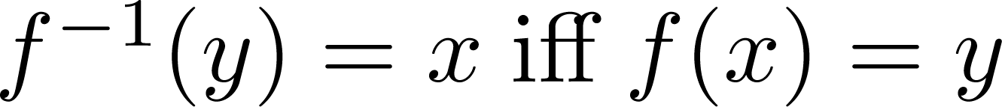
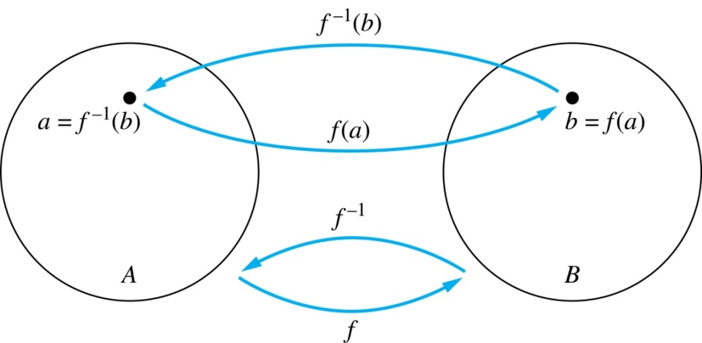
Inverse of a Function (CO1)
Definition: Let f be a bijection from A to B. Then the inverse of f, denoted f ^{–1}, is the function from B to A defined as
No inverse exists unless f is a bijection.

Slide 88
Inverse of a Function (CO1)
Example 1:
Let f be the function from {a,b,c} to {1,2,3}
f(a)=2, f(b)=3, f(c)=1.
Is f invertible and if so what is its inverse?
Solution:
f is invertible because it is a bijection
f ^{–1} reverses the correspondence given by f:
f ^{–1}(1)=c, f ^{–1}(2)=a, f ^{–1}(3)=b.

Slide 89
Inverse of a Function (CO1)
Example 2:
Let f: R → R be such that f(x) = x²
Is f invertible, and if so, what is its inverse?
Solution:
The function f is not invertible because it is not one-to-one

Slide 90
Inverse of a Function (CO1)
Example 3:
Let f: Z → Z be such that f(x) = x + 1
Is f invertible and if so what is its inverse?
Solution:
The function f is invertible because it is a bijection
f ^{–1} reverses the correspondence:
f ^{–1}(y) = y – 1

Slide 91
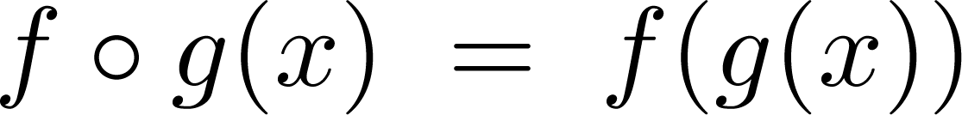
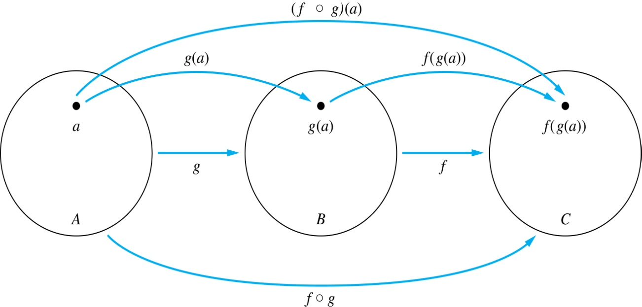
Composition of function (CO1)
Definition: Let f: B → C, g: A → B. The composition of f with g, denoted f ∘ g is the function from A to C defined by

Slide 92
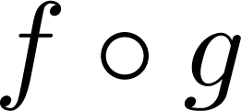
Composition of function (CO1)
A
g
B
f
C
A
C
a
v
a
h
h
b
i
b
i
w
c
c
x
j
j
d
d
y

Slide 93




Composition of function (CO1)
Example: If and then
and

Slide 94
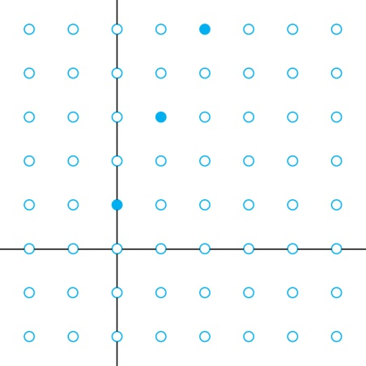
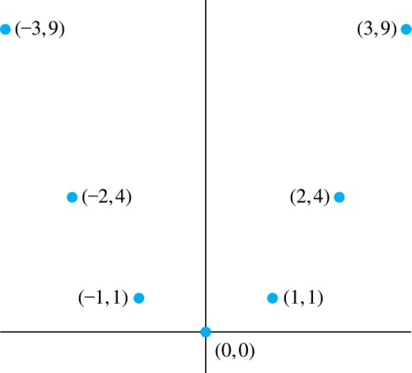
Graphs of Functions (CO1)
Let f be a function from the set A to the set B. The graph of the function f is the set of ordered pairs
{(a,b) | a ∈A and f(a) = b}
Graph of f(n) = 2n+1
from Z to Z
Graph of f(x) = x²
from Z to Z

Slide 95
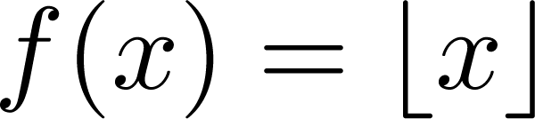
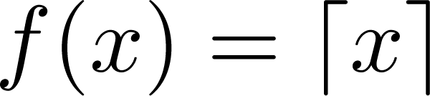
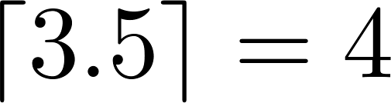
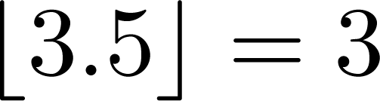
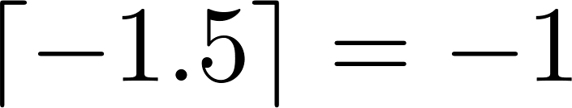
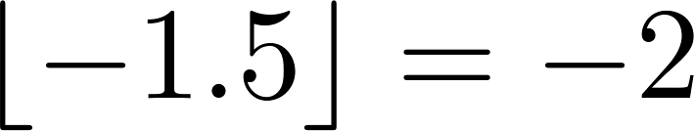
Some Important Functions (CO1)
The floor function, denoted
is the largest integer less than or equal to x.
The ceiling function, denoted
is the smallest integer greater than or equal to x
Examples:

Slide 96
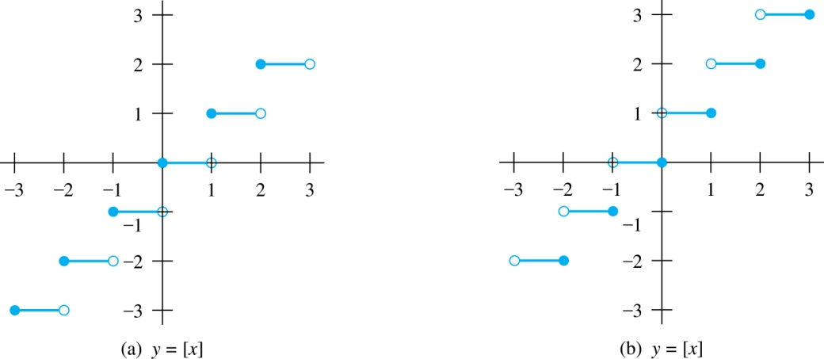
Some Important Functions (CO1)
Floor Function (≤x) Ceiling Function (≥x)

Slide 97
Factorial Function (CO1)
Definition: f: N → Z⁺, denoted by f(n) = n! is the product of the first n positive integers:
f(n) = 1 ∙ 2 ∙∙∙ (n–1) ∙ n for n>0
f(0) = 0! = 1
Examples:
f(1) = 1! = 1
f(2) = 2! = 1 ∙ 2 = 2
f(6) = 6! = 1 ∙ 2 ∙ 3 ∙ 4 ∙ 5 ∙ 6 = 720
f(20) = 2,432,902,008,176,640,000

Slide 98
Topic Objective: Combinatorics (CO1)
The student will be able to:
perform counting of specified structures, sometimes referred to as arrangements or configurations in a very general sense, associated with finite systems.
find the "best" structure or solution among several possibilities, be it the "largest", "smallest" or satisfying some other optimality criterion.

Slide 99
Topic Prerequisite & Recap
Prerequisite
Basic Understanding of Probability and Combination.
Counting Principles of sum and product rule.
Recap
The concepts of set, relation and function.

Slide 100
Combinatorics (CO1)
Combinatorics: also called combinatorial mathematics, the field of mathematics concerned with problems of selection, arrangement, and operation within a finite or discrete system. Included is the closely related area of combinatorial geometry
Combinatorics is an area of mathematics primarily concerned with counting, both as a means and an end in obtaining results, and certain properties of finite structures. It is closely related to many other areas of mathematics and has many applications ranging from logic to statistical physics, from evolutionary biology to computer science, etc

Slide 101
Basic Counting Techniques (CO1)
Sum Rule Principle: Assume some event E can occur in m ways and a second event F can occur in n ways, and suppose both events cannot occur simultaneously. Then E or F can occur in m + n ways.
In general, if there are n events and no two events occurs in same time then the event can occur in n₁+n₂..........n ways.
Example: If 8 male processor and 5 female processor teaching DMS then the student can choose professor in 8+5=13 ways.
Product Rule Principle: Suppose there is an event E which can occur in m ways and, independent of this event, there is a second event F which can occur in n ways. Then combinations of E and F can occur in mn ways.
In general, if there are n events occurring independently then all events can occur in the order indicated as n₁ x n₂ x n₃.........n ways.
Example: In class, there are 4 boys and 10 girls if a boy and a girl have to be chosen for the class monitor, the students can choose class monitor in 4 x 10 = 40 ways.

Slide 102
Basic Counting Techniques (CO1)
Composition table(CO1)
Factorial Function: The product of the first n natural number is called factorial n. It is denoted by n!, read "n Factorial."
The Factorial n can also be written as
n! = n (n-1) (n-2) (n-3)......1.
0! = 1.
Example: Find the value of 5!
Solution:
5! = 5 x (5-1) (5-2) (5-3) (5-4) = 5 x 4 x 3 x 2 x 1 = 120

Slide 103
Permutation(CO1)
Algebraic structures(CO1)
Any arrangement of a set of n objects in a given order is called Permutation of Object. Any arrangement of any r ≤ n of these objects in a given order is called an r-permutation or a permutation of n object taken r at a time.
It is denoted by P (n, r)
P(n,r)=n!/(n−r)!
Permutation relates to the act of arranging all the members of a set into some sequence or order.
If the set is already ordered, then the rearranging of its elements is called the process of permuting.
Permutations occur, in more or less prominent ways, in almost every area of mathematics. They often arise when different orderings on certain finite sets are considered
The example of permutations is the number of 2 letter words which can be formed by using the letters in a word say, GREAT; 5P_2 = 5!/(5-2)!

Slide 104
Combination(CO1)
Monoid Example(CO1)
The combination is a way of selecting items from a collection, such that (unlike permutations) the order of selection does not matter.
In smaller cases, it is possible to count the number of combinations.
Combination refers to the combination of n things taken k at a time without repetition. To refer to combinations in which repetition is allowed, the terms k-selection or k-combination with repetition are often used.
The formula for combinations is: nCr = n!/[r! (n-r)!]
The example of combinations is in how many combinations we can write the words using the vowels of word GREAT; 5C_2 =5!/[2! (5-2)!]

Slide 105
Balls and bins Problem(CO1)
Imagine that you have a collection of bins and a pile of balls. You want to distribute the balls into the bins.
We will study 3 different rules for the mapping assigning the balls to the bins.
There must be at most 1 ball in each box: the mapping is injective.
There must be at least 1 ball in each box: the mapping is surjective
There are no restrictions on how many balls are in each box; the mapping is unrestricted. (“Injective” means one-to-one: “surjective” means onto.)
Now, there are 2 possibilities regarding the collection of balls:
The balls could be indistinguishable from each other (i.e. every ball is exactly the same); or
the balls could be distinguishable from each other (suppose e.g. the balls are painted different colors).

Slide 106
Balls and bins Problem(CO3)
Also, there are 2 possibilities for the bins:
The bins could either be indistinguishable from each other, or
Or, they could distinguishable from each other (say, there is a number painted on the side of each box).
We will hereafter sometimes use the term urn to refer to the bins. The advantage is that the words “ball” and “urn” start with different letters.
So let B be a set of balls and let U be a set of bins (or urns), with |B| = b, |U| = u.
Here is a table that we will fill in, showing the number of ways to put the balls into the bins under each circumstance.

Slide 107
Balls and bins Problem(CO3)
How many ways are there to put b distinguishable balls in the u distinguishable urns with no restrictions on the mapping?
There are u choices of bins for 1st ball AND u choices for bins for 2nd ball AND ... AND u choices for the bth ball. Using the Product Rule, we can see that the number of ways is (u power(b) ).
Example 1 : Imagine that there are 10 possible pizza toppings and we need to choose which ones to have on our pizza. How many possible different pizza combinations are there? (Rephrase this in terms of balls and bins!)
The balls are the pizza toppings. Each topping can be on the pizza or not on the pizza, so it goes in one of two “bins”. Since b = 10 and u = 2, there are (2 power(10)) different combinations

Slide 108
Pigeonhole Principle(CO1)
Pigeonhole principle is one of the simplest but most useful ideas in mathematics.
Type of counting argument, can be used to demonstrate possibly unexpected results.
The most straightforward application is to finite sets (such as pigeons and boxes), it is also used with infinite sets that cannot be put into one-to-one correspondence.

Slide 109
Prerequisite and recap: Pigeonhole Principle(CO1)
Prerequisite
Counting techniques like probability and combinations.
Recap
Proof techniques for solving various counting problems.

Slide 110
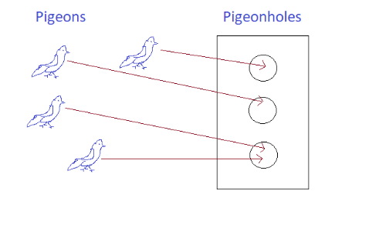
Pigeonhole Principle(CO1)
The Pigeonhole Principle says that if you have more pigeons than pigeonholes, then at least one pigeonhole will get two pigeons.
If you have a function from a finite set to a smaller finite set, then the function cannot be one-to-one; in other words, there must be at least two elements in the domain with the same image in the codomain.
Theorem :Pigeonhole Principle
If f:X→Y .where X and Y are finite sets with |X|>|Y|, then f is not one-to-one.

Slide 111
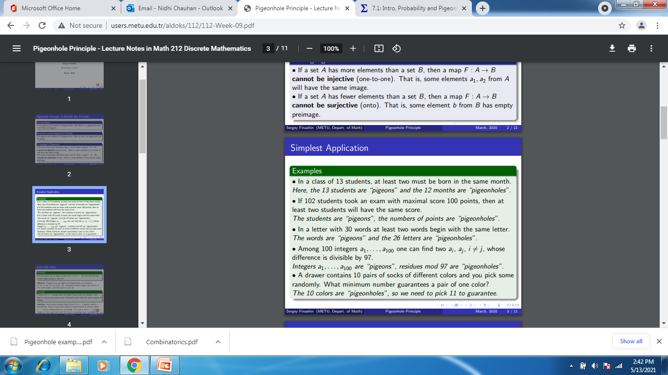
Pigeonhole Principle Problem(CO1)

Slide 112
Generalized Pigeonhole Principle (CO1)
Extended Pigeonhole Principle (EPP): If nk+1 objects are placed in n boxes, then one of the boxes must contain at least k+1 objects.
Generalized Pigeonhole Principle (GPP): If nk+s or more objects are placed in n boxes, then for each 0 ≤ m ≤ n there exist m boxes with a total of at least mk + min(s,m) objects
Example: There are 42 students who are to share 12 computers. Each student uses exactly one computer and no computer is used by more than six students. Then at least five computers are used by three or more students.
If we removed the condition that no computer is used by more than six students, then the conclusion is not necessarily true anymore. However, GPP can be used to prove the following statement:
There are 42 students who are to share 12 computers. Each student uses exactly one computer. Then there are five computers that are used by a total of 20 or more students and there are five computers used by a total of at most 15 students.

Slide 113
Objectives of Topic: Recurrence Relation(CO1)
Implementation of recursive techniques that can derive sequences and be useful for solving counting problems.cc

Slide 114
Prerequisite and recap: Recurrence Relation(CO1)
Prerequisite
Counting problems.
Recap
Problem solving using probability and combination.

Slide 115
Recurrence Relation(CO1)
A recurrence relation is a functional relation between the independent variable x, dependent variable f(x) and the differences of various order of f (x). A recurrence relation is also called a difference equation, and we will use these two terms interchangeably.
Example1: The equation f (x + 3h) + 3f (x + 2h) + 6f (x + h) + 9f (x) = 0 is a recurrence relation.
It can also be written as a_{r+3} + 3a_{r+2} + 6a_{r+1} + 9a_{r} = 0
A recurrence relation is an equation that recursively defines a sequence where the next term is a function of the previous terms. First few term are called initial condition of recurrence relation
Example 1 Fibonacci series F_{n} = F_{n−1}+ F_{n−2}
Example 2 a_{n} = a_{n−1}+ 2 with a₀ = 1

Slide 116
Order & Degree of Recurrence Relation(CO1)
Order of the Recurrence Relation:
The order of the recurrence relation or difference equation is defined to be the difference between the highest and lowest subscripts of f(x) or a_{r}=y_{k}.
Example1: The equation 13a_{r}+20a_{r-1}=0 is a first order recurrence relation.
Example2: The equation 8f (x) + 4f (x + 1) + 8f (x+2) = k (x)
Degree of the Difference Equation:
The degree of a difference equation is defined to be the highest power of f (x) or a_{r}=y_{k}
Example1: The equation y³_{k+3}+2y²_{k+2}+2y_{k+1}=0 has the degree 3, as the highest power of y_{k} is 3.
Example2: The equation a⁴_{r}+3a³_{r-1}+6a²_{r-2}+4a_{r-3} =0 has the degree 4, as the highest power of a_{r} is 4.

Slide 117
Linear Recurrence Relation(CO1)
A linear recurrence equation of degree k or order k is a recurrence equation which is in the format
x_{n} = A₁x_{n−1}+A₂x_{n−2}+A₃x_{n−3}+…..+A_{k}x_{n - k} (A_{n} is a constant and A_{k}≠0) on a sequence of numbers as a first-degree polynomial.
Each term of a sequence is a linear function of earlier terms in the sequence.
For example: a0 = 1 a1 = 6 a2 = 10
an = an−1 + 2 an−2 + 3 an−2
a3 = a0 + 2a1 + 3a2
= 1 + 2(6) + 3(10) = 43

Slide 118
Linear Recurrence Relation Types(CO1)
Linear recurrences has following types:
Linear homogeneous recurrences
Linear non-homogeneous recurrences

Slide 119
Linear homogeneous recurrences(CO1)
A linear homogenous recurrence relation of degree k with constant coefficients is a recurrence relation of the form
an = c1 an-1 + c2 an-2 + … + ck an-k,
where c1, c2, …, ck are real numbers, and ck ≠ 0, an is expressed in terms of the previous k terms of the sequence, so its degree is k. This recurrence includes k initial conditions.
a0 = C0
a1 = C1 ……………………… ak = Ck

Slide 120
Solution of linear Recurrence Relation(CO1)
We can find any solution of the form an = r^{n} that satisfies the recurrence relation.
Recurrence relation are given in that form
an = c1 an-1 + c2 an-2 + …………………. + ckan-k
Put the values an = r^{n} in above recurrence relation
r^{n} = c₁r^{n-1} - c₂r^{n-2} - … - c_{k}r^{n-k}
r^{n} - c₁r^{n-1} - c₂r^{n-2} - … - c_{k}r^{n-k} = 0
dividing both sides by r^{n-k}
r^{k} - c₁r^{k-1} - c₂r^{k-2} - … - c_{k} = 0
This equation is called the characteristic equation

Slide 121
Linear Recurrence Relation Example(CO1)
Question1 What is the solution of the recurrence relation
a_{n} = a_{n-1} + 2a_{n-2} with a₀=2 and a₁=7?
Solution: Since it is linear homogeneous recurrence, first find its characteristic equation
r² - r - 2 = 0
(r+1)(r-2) = 0
r₁ = 2 and r₂ = -1
So, a_{n} = A2^{n} + B(-1)^{n} is a solution.

Slide 122
Solution of linear Recurrence Relation(CO1)
Now we should find A and B using initial conditions.
Put n = 0 and 1 in above equation
a₀ = A + B = 2
a₁ = 2A - B = 7
Solve above these equation A = 3 and B = -1
a_{n} = 3.2^{n} - (-1)^{n} is a solution.

Slide 123
Linear Recurrence Relation Example with initial conditions(CO1)
Question 2 What is the solution of the recurrence relation
a_{n} = 6a_{n-1} - 9a_{n-2} with a₀=1 and a1=6?
Solution: First find its characteristic equation
r² - 6r + 9 = 0
(r - 3)² = 0 r₁ = 3
So, by theorem a_{n} = (A + Bn) (3)^{n} is a solution.
Now we should find constants using initial conditions.
A = 1 and B= 1
a_{n} = 3^{n} + n3^{n} is a solution.

Slide 124
Linear Recurrence Relation Example with initial conditions(CO1)
Question 3 What is the solution of the recurrence relation
a_{n} = -3a_{n-1} - 3a_{n-2} - a_{n-3} with a₀=1, a₁=-2 and a₂=-1?
Solution Find its characteristic equation
r³ + 3r² + 3r + 1 = 0
(r + 1)³ = 0 then r₁= -1
Then an = (A + B n + Cn²)(-1)^{n} is a solution.
Now we should find constants using initial conditions. And find the value of A, B and C
A = 1 B = 3 C = -2
Then put the value of A, B and C in above equation
a_{n} = (1 + 3n - 2n²) (-1)^{n} is a solution.

Slide 125
Linear Homogeneous Recurrence Relations with Constant Coefficients(CO1)
To find the solution of the linear homogeneous difference equations, we have the four cases that are discussed as follows:
Case1: If the characteristic equation has n distinct real roots∝₁, ∝₂, ∝₃,.......∝_{n}.
Thus, are all solutions of equation (i).
Also, we have are all solutions of equation (i). The sums of solutions are also solutions.
Hence, the homogeneous solutions of the difference equation are
Case2: If the characteristics equation has repeated real roots.
If ∝₁=∝₂, then (A₁+A₂ K) is also a solution.
If ∝₁=∝₂=∝₃ then (A₁+A₂ K+A₃ K²) is also a solution.
Similarly, if root ∝₁ is repeated n times, then.
(A₁+A₂ K+A₃ K²+......+A_{n} K_{n-1})
The solution to the homogeneous equation.

Slide 126
Linear Homogeneous Recurrence Relations with Constant Coefficients(CO1)
Case3: If the characteristics equation has one imaginary root.
If α+iβ is the root of the characteristics equation, then α-iβ is also the root, where α and β are real.
Thus, (α+iβ)^{K} and (α-iβ)^{K} are solutions of the equations. This implies (α+iβ)^{K} A₁+α-iβ)^{K} A₂
Is also a solution to the characteristics equation, where A₁ and A₂ are constants which are to be determined.
Case4: If the characteristics equation has repeated imaginary roots.
When the characteristics equation has repeated imaginary roots,
(C₁+C₂ k) (α+iβ)^{K} +(C₃+C₄ K)(α-iβ)^{K} is the solution to the homogeneous equation.
Example1: Solve the difference equation a_{r} - 3 a_{r-1} + 2 a_{r-2=0.}
Solution: The characteristics equation is given by
s²-3s+2=0or(s-1)(s-2)=0 ⇒ s = 1, 2
Therefore, the homogeneous solution of the equation is given by a_{r}=C¹_{r}+C².2^{r}.

Slide 127
Homogeneous Linear Difference Equations and Particular Solution(CO1)
Example: Solve the difference equation a_{r}-4a_{r-1}+4a_{r-2}=0 and find particular solutions such that a₀=0 and a₁=6.
Solution: The characteristics equation is s²-4s+4=0 or (s-2)²=0 s = 2, 2
Therefore, the homogeneous solution of the equation is given by a_{r(n)}=(C₁+C₂ r).2^{r}.............. equation (i)
Putting r = 0 and r = 1 in equation (i), we get a₀=(C₁+0).2⁰ = 1 ∴C₁=1 a₁=(C₁+C₂).2=6 ∴C₁+C₂=3⇒C₂=2
Hence, the particular solution is a_{r(P)}=(1+2r).2^{r}.

Slide 128
Linear non-homogeneous recurrences(CO1)
A linear non-homogenous recurrence relation with constant coefficients is a recurrence relation of the form
a_{n} = c₁ a_{n-1} + c₂ a_{n-2} + ………….. + c_{k} a_{n-k}+ f(n)
where c₁, c₂, …….., c_{k} are real numbers, and f(n) is a function depending only on n.
The recurrence relation
a_{n} = c₁ a_{n-1} + c₂ a_{n-2} + ………….. + c_{k} a_{n-k} is called the associated homogeneous recurrence relation.
This recurrence includes k initial conditions.
a₀ = C₀ a₁ = C₁… a_{k} = C_{k}

Slide 129
Linear non-homogeneous recurrences(CO1)
The following recurrence relations are linear non homogeneous
recurrence relations.
Example 1 a_{n} = a_{n-1} + 2^{n}
Example 2 a_{n} = a_{n-1} + a_{n-2} + n² + n + 1
Example 3 a_{n} = a_{n-1} + a_{n-4} + n!
Example 4 a_{n} = a_{n-6} + n2^{n}

Slide 130
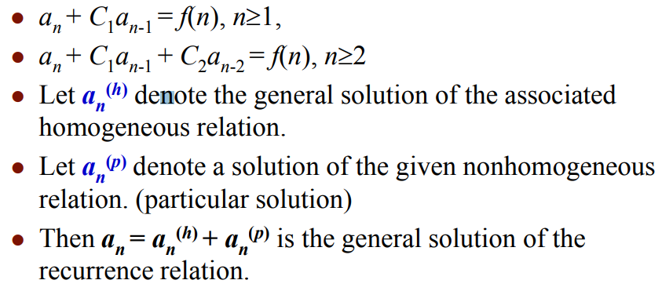
Linear non-homogeneous recurrences(CO1)

Slide 131
Linear non-homogeneous recurrences Example(CO1)
Q1 What is the solution of the recurrence relation
a_{n} = 2a_{n-1} - a_{n-2} + 2^{n} for n>=2,
with a₀=1 and a₁=2?
Solution: Since it is linear non-homogeneous recurrence, b_{n}
is similar to f(n) then b_{n} = c2^{n} + d
b_{n} = 2b_{n-1} - b_{n-2} + 2^{n}
c2^{n} + d = 2(c2^{n-1} + d) - (c2^{n-2} + d) + 2n
c2^{n} + d = c2^{n} + 2d - c2^{n-2} - d + 2n
0 = (-4c + 4c - c + 4)2^{n-2} + (-d + 2d -d)
c = 4 and d=0
then b_{n} = 4.2^{n}.

Slide 132
Order of Linear Non-Homogeneous Recurrence Relation (CO1)
The equation is said to be linear homogeneous difference equation if and only if R (n) = 0 and it will be of order n.
The equation is said to be linear non-homogeneous difference equation if R (n) ≠ 0.
Example1: The equation a_{r+3}+6a_{r+2}+12a_{r+1}+8a_{r}=0 is a linear non-homogeneous equation of order 3.
Example2: The equation a_{r+2}-4a_{r+1}+4a_{r}= 3r + 2^{r} is a linear non-homogeneous equation of order 2.
A linear homogeneous difference equation with constant coefficients is given by
C₀ y_{n}+C₁ y_{n-1}+C₂ y_{n-2}+⋯......+C_{r} y_{n-r}=0 ....... equation (i)
Where C₀,C₁,C₂.....C_{n} are constants.

Slide 133
Topic objective: Generating function (CO1)
It will be useful in solving recurrence relations.
proving some of the combinatorial identities.
It will help finding asymptotic formulae for terms of sequences.

Slide 134
Prerequisite and recap: Generating function (CO1)
Prerequisite
Recurrence relation and functions.
Recap
Use of recurrence relation to solve variety of counting problems.

Slide 135
Generating Function(CO1)
Generating function is a method to solve the recurrence relations.
Let us consider, the sequence a₀, a₁, a₂....a_{r} of real numbers. For some interval of real numbers containing zero values at t is given, the function G(t) is defined by the series G(t)= a₀, a₁t+a₂ t²+⋯+a_{r} t_{r}+............equation (i)
This function G(t) is called the generating function of the sequence a_{r}.

Slide 136
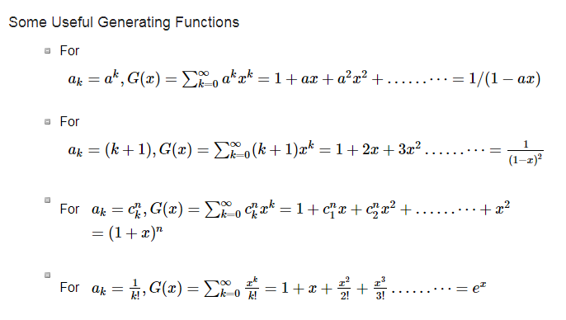
Generating Function(CO1)

Slide 137
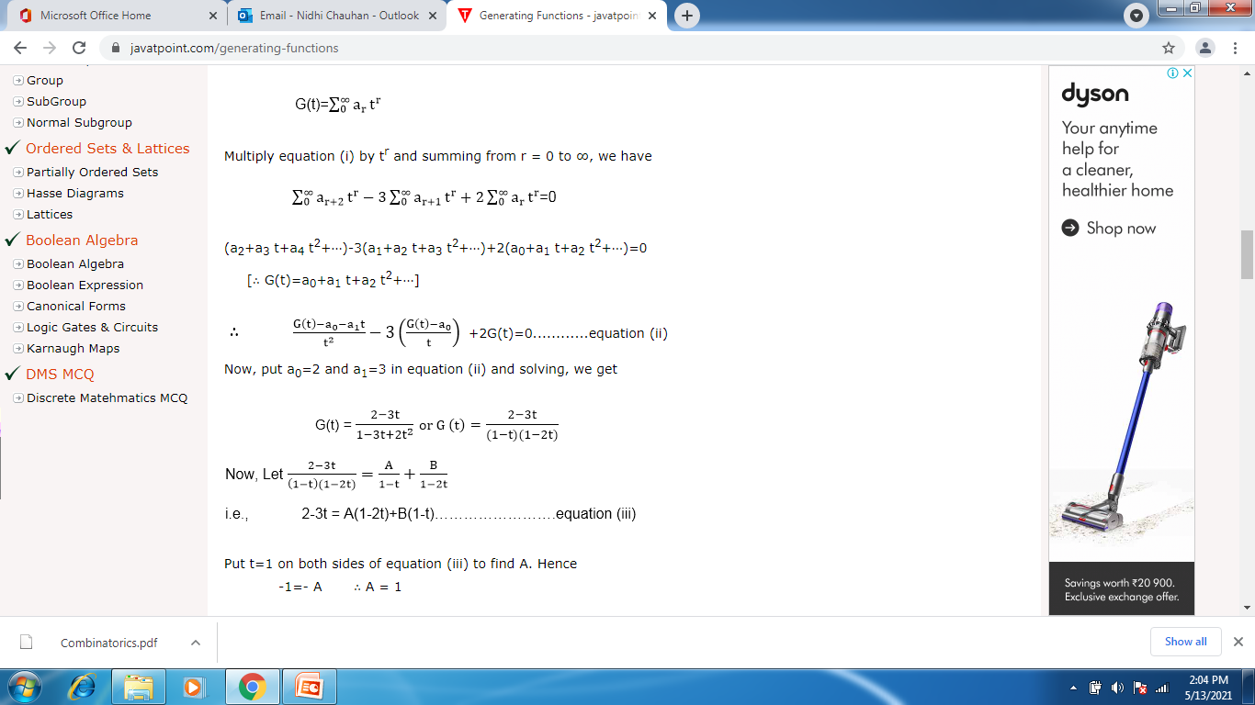
Generating Function example(CO1)
Example: Solve the recurrence relation a_{r+2}-3a_{r+1}+2a_{r}=0.By the method of generating functions with the initial conditions a₀=2 and a₁=3.
Solution: Let us assume that

Slide 138
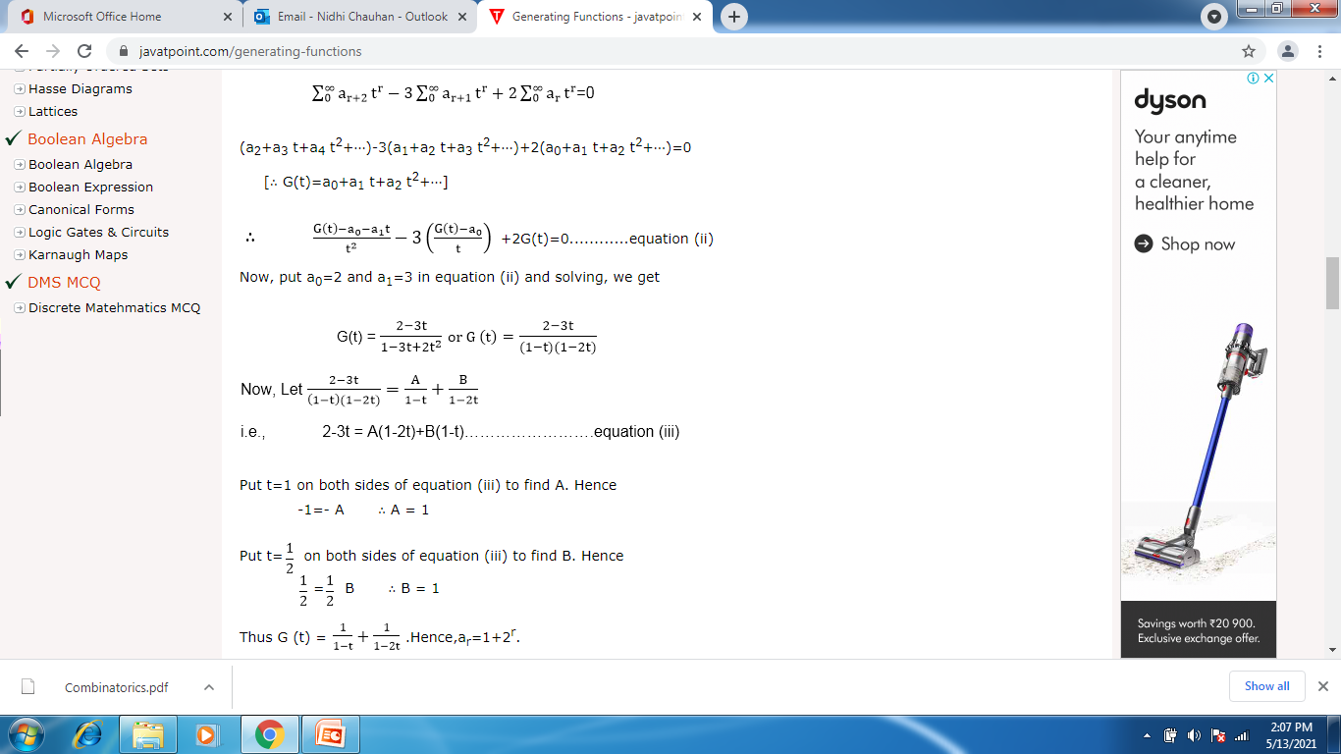
Generating Function(CO1)

Slide 139
Topic objective: Proof Techniques(CO1)
Mathematical proof of an argument to give logic to validate a mathematical statement.

Slide 140
Prerequisite and Recap: Proof Techniques(CO1)
Prerequisite
Logical operators like AND, OR, NOT, If then, and If and only if.
Quantifiers like for all and there exists.
Recap
Counting using Recurrences and generating functions.

Slide 141
Proof Techniques(CO1)
Direct proof.
Proof by contradiction.
Proof by mathematical induction.
In mathematics and logic, a direct proof is a way of showing the truth or falsehood of a given statement by a straightforward combination of established facts, usually axioms, existing lemmas and theorems, without making any further assumptions
In mathematics, proof by contrapositive, or proof by contraposition, is a rule of inference used in proofs, where one infers a conditional statement from its contrapositive. In other words, the conclusion "if A, then B" is inferred by constructing a proof of the claim "if not B, then not A" instead.

Slide 142
Proof Techniques- Contra-positive(CO1)
Proof by contrapositive, or proof by contraposition, is a rule of inference used in proofs, where one infers a conditional statement from its contrapositive. In other words, the conclusion "if A, then B" is inferred by constructing a proof of the claim "if not B, then not A" instead.
Contrapositive:
The contrapositive of a conditional statement of the form "If p then q" is "If ~q then ~p". Symbolically, the contrapositive of p q is ~q ~p.

Slide 143
Proof Techniques- Contradiction(CO1)
In logic and mathematics, proof by contradiction is a form of proof that establishes the truth or the validity of a proposition, by showing that assuming the proposition to be false leads to a contradiction.
Example :Prove that sqrt(2) is irrational Suppose sqrt(2) is rational.
sqrt(2) = a/b for some integers a and b with b != 0. Let us choose integers a and b with sqrt(2) = a/b, such that b is positive and as small as possible. (Well-Ordering Principle)
a^2 = 2b^2 Since a^2 is even, it follows that a is even. a = 2k for some integer k, so a^2 = 4k^2 b^2 = 2k^2. Since b^2 is even, it follows that b is even. Since a and b are both even, a/2 and b/2 are integers with b/2 > 0, and sqrt(2) = (a/2)/(b/2), because (a/2)/(b/2) = a/b. But it contradicts our assumption b is as small as possible. Therefore sqrt(2) cannot be rational.

Slide 144
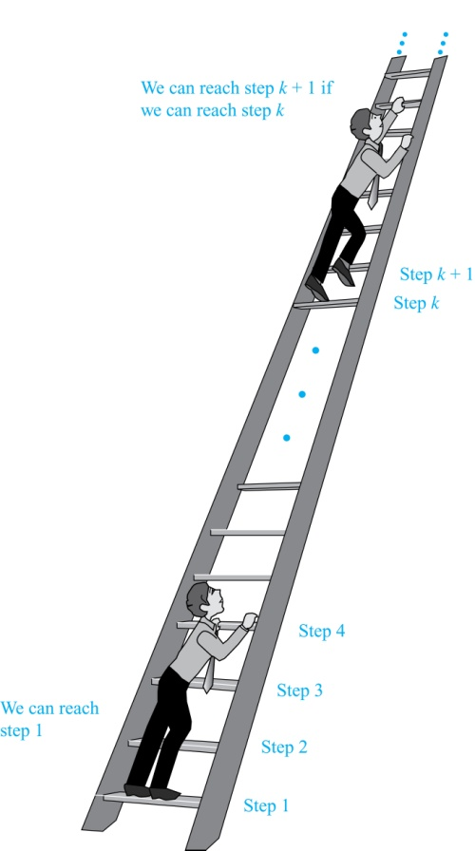
Principle of Mathematical Induction (CO1)
Discrete mathematics is more concerned with number systems such as the integers, whole numbers, etc...
Mathematical Induction is a mathematical technique which is used to prove a statement, a formula or a theorem is true for every natural number.
Suppose we have an infinite ladder:
We can reach the first rung of the ladder.
If we can reach a particular rung of the ladder, then we can reach the next rung.
Can we reach every step on the ladder?

Slide 145
Principle of Mathematical Induction (CO1)
Principle of Mathematical Induction: To prove that P(n) is true for all positive integers n, we complete these steps:
Basis Step: Show that P(1) is true.
Inductive Step: Show that P(k) → P(k + 1) is true for all positive integers k.
To complete the inductive step, assuming the inductive hypothesis that P(k) holds for an arbitrary integer k, show that must P(k + 1) be true.
Climbing an Infinite Ladder Example:
BASIS STEP: By (1), we can reach rung 1.
INDUCTIVE STEP: Assume the inductive hypothesis that we can reach rung k. Then by (2), we can reach rung k + 1.
Hence, P(k) → P(k + 1) is true for all positive integers k. We can reach every rung on the ladder.

Slide 146
Principle of Mathematical Induction (CO1)
Mathematical induction can be expressed as the rule of inference
(P(1) ∧ ∀k (P(k) → P(k + 1))) → ∀n P(n),
where the domain is the set of positive integers.
In a proof by mathematical induction, we don’t assume that P(k) is true for all positive integers! We show that if we assume that P(k) is true, then P(k + 1) must also be true.
Proofs by mathematical induction do not always start at the integer 1. In such a case, the basis step begins at a starting point b where b is an integer.
Mathematical induction is valid because of the well ordering property

Slide 147
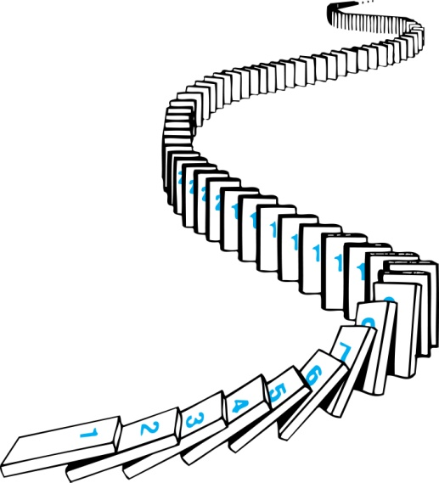
How Mathematical Induction Works (CO1)
Consider an infinite sequence of dominoes, labeled 1,2,3, …, where each domino is standing.
Let P(n) be the proposition that the n^{th} domino is knocked over.
know that the first domino is knocked down, i.e., P(1) is true.
We also know that if whenever the k^{th} domino is knocked over, it knocks over the (k + 1)^{st} domino, i.e, P(k) → P(k + 1) is true for all positive integers k.
Hence, all dominos are knocked over.
P(n) is true for all positive integers n.

Slide 148
Examples of mathematical induction (CO1)
Example 1: Show that: for all positive integers.
Solution:
BASIS STEP: P(1) is true since 1(1 + 1)/2 = 1.
INDUCTIVE STEP: Assume true for P(k).
The inductive hypothesis is
Under this assumption,
Hence, we have shown that P(k + 1) follows from P(k). Therefore the sum of the first n positive integers is

Slide 149
Faculty Video Links, Youtube & NPTEL Video Links and Online Courses Details (CO1)
Youtube/other Video Links
https://swayam.gov.in/nd1_noc19_cs49
https://www.youtube.com/watch?v=Dsi7xA89Mw&list=PL0862D1A94725 2D20&index=28
https://www.youtube.com/watch?v=74l6t4_4pDg&list=PL0862D1A947252D20&index=29
NEPTEL video link:
https://nptel.ac.in/courses/111/105/111105112/

Slide 150
Daily Quiz (CO1)
Q1. Consider the recurrence relation a₁=4, a_{n}=5n+a_{n-1}. The value of a₆₄ is _________ (a) 10399 (b) 23760 (c) 75100 (d) 53700
Q2. Determine the solution of the recurrence relation
F_{n} = 20F_{n-1} − 25F_{n-2} where F₀ = 4 and F₁ =14. (a) a_{n} = 14*5^{n-1} (b) a_{n} = 7/2*2^{n}−1/2*6^{n}
(c) a_{n} = 7/2*2^{n}−3/4*6^{n+1} (d) a_{n} = 3*2^{n}−1/2*3^{n}
Q3. Find the value of a₄ for the recurrence relation a_{n}=2a_{n-1}+3, with a₀=6. (a) 320 (b) 221 (c) 141 (d) 65

Slide 151
Daily Quiz(CO1)
Q4. What is the recurrence relation for 1, 7, 31, 127, 499? a) b_{n+1}=5b_{n-1}+3 b) b_{n}=4b_{n}+7! c) b_{n}=4b_{n-1}+3 d) b_{n}=b_{n-1}+1
Q5. Find the value of a₄ for the recurrence relation a_{n}=2a_{n-1}+3, with a₀=6. a) 320 b) 221 c) 141 d) 65
Q6. Determine the value of a2 for the recurrence relation a_{n} = 17a_{n-1} + 30n with a₀=3. a) 4387 b) 5484 c) 238 d) 1437

Slide 152
Daily Quiz(CO1)
Q7. Determine the number of ways In a single competition a singing couple from 5 boys and 5 girls can be formed so that no girl can sing a song with their respective boy? a) 123 b) 44 c) 320 d) 21
Q8. In a picnic with 20 persons where 6 chocolates will be given to the top 8 children(the chocolates are distinct: first, second). How many ways can this be done? a) ¹⁸C₆ b) ²⁰P₆ c) ²⁵C₄ * 6! d) ¹⁹P₅
Q9. There are 28 identical oranges that are to be distributed among 8 distinct girls. How many ways are there to distribute the oranges? a) ²²P₇ b) ³⁴C₆ c) ³⁵C₇ d) ²⁸C₈

Slide 153
Daily Quiz(CO1)
Q10. Determine the number of ways In a single competition a singing couple from 5 boys and 5 girls can be formed so that no girl can sing a song with their respective boy? a) 123 b) 44 c) 320 d) 21
Q11. In a picnic with 20 persons where 6 chocolates will be given to the top 8 children(the chocolates are distinct: first, second). How many ways can this be done? a) ¹⁸C₆ b) ²⁰P₆ c) ²⁵C₄ * 6! d) ¹⁹P₅
Q12.A woman has 14 identical pens to distribute among a group of 10 distinct students. How many ways are there to distribute the 14 pens such that each student gets at least one pencil? a) ¹⁵C₁₀ b) ¹⁰C₅ * 11 c) ¹⁵C₈ * 4! d) ¹³C₉

Slide 154
Daily Quiz(CO1)
13. Which sentence is true? A. Set of all matrices forms a group under multiplication B. Set of all rational negative numbers forms a group under multiplication C. Set of all non-singular matrices forms a group under multiplication D. Both (b) and (c)
14. Which statement is false? A. The set of rational integers is an abelian group under addition B. The set of rational numbers form an abelian group under multiplication C. The set of rational numbers is an abelian group under addition D. None of these
15. What is the identity element In the group G = {2, 4, 6, 8) under multiplication modulo 10? A. 5 B. 9 C. 6 D. 12

Slide 155
Daily Quiz(CO1)
Q16. In which of the following problems recurrence relation holds? a) Optimal substructure b) Tower of Hanoi c) Hallmark substitution d) Longest common subsequence
Q17. Every recursive algorithm must have the problem of ________ a) overhead of repeated function calls b) collision of different function calls c) searching for all duplicate elements d) make only two recursive calls
Q18. In the principle of mathematical induction, which of the following steps is mandatory? a) induction hypothesis b) inductive reference c) induction set assumption d) minimal set representation

Slide 156
Daily Quiz(CO1)
Q19. For every natural number k, which of the following is true? a) (mn)^{k} = m^{k}n^{k} b) m*k = n + 1 c) (m+n)^{k} = k + 1 d) m^{k}n = mn^{k}
Q 20. Which of the following is the base case for 4^{n+1} > (n+1)² where n = 2? a) 64 > 9 b) 16 > 2 c) 27 < 91 d) 54 > 8

Slide 157
Weekly Assignment
Q1. Find the first four terms each of the following recurrence relation
a_{k} = 2a_{K-1}+k For all integers k >= 2, a₁ = 1
Q2. Solve the recurrence relation a_{n} - a_{n-1}+2a_{n-2} =0 then find the particular solution a_{o} = 0 and a₁ = 1
Q3. Find N if 2P ( N, 2) + 50 =P (2N, 2).
Q4. Solve the recurrence relation a_{n+2} - 5a_{n+1}+6a_{n} =2 with initial condition a_{o} = 1 and a₁ = -1.
Q5. Find the recurrence relation with initial condition for the following:
2, 10, 50, 250, …….
Q6. Solve the recurrence relation y_{n+2} - Y_{n+1} - 2y_{n} =n²
Q7. Define Pigeonhole counting theory.

Slide 158
MCQs(CO1)
1. In a group there must be only __________ element. a) 1 b) 2 c) 3 d) 5
2. _____ is the multiplicative identity of natural numbers. a) 0 b) -1 c) 1 d) 2
3. The set of even natural numbers, {6, 8, 10, 12,..,} is closed under addition operation. Which of the following properties will it satisfy? a) closure property b) associative property c) symmetric property d) identity property
4. If (M, *) is a cyclic group of order 73, then number of generator of G is equal to ______ a) 89 b) 23 c) 72 d) 17

Slide 159
MCQs(CO1)
Q 5. There are 15 people in a committee. How many ways are there to group these 15 people into 3, 5, and 4? a) 846 b) 2468 c) 658 d) 1317
Q6. How many ways are there to divide 4 Indian countries and 4 China countries into 4 groups of 2 each such that at least one group must have only Indian countries? a) 6 b) 45 c) 12 d) 76
Q 7. From a group of 8 men and 6 women, five persons are to be selected to form a committee so that at least 3 women are there on the committee. In how many ways can it be done? a) 686 b) 438 c) 732 d) 549

Slide 160
MCQs(CO1)
Q 8. The least number of computers required to connect 10 computers to 5 routers to guarantee 5 computers can directly access 5 routers is ______ a) 74 b) 104 c) 30 d) 67
Q9. In a group of 267 people how many friends are there who have an identical number of friends in that group? a) 266 b) 2 c) 138 d) 202
Q10. How many numbers must be selected from the set {1, 2, 3, 4} to guarantee that at least one pair of these numbers add up to 7? a) 14 b) 5 c) 9 d) 24

Slide 161
MCQs(CO1)
Q11. A group of 20 girls plucked a total of 200 oranges. How many oranges can be plucked one of them? a) 24 b) 10 c) 32 d) 7
Q12. In a get-together party, every person present shakes the hand of every other person. If there were 90 handshakes in all, how many persons were present at the party? a) 15 b) 14 c) 16 d) 17
Q13. A bag contains 25 balls such as 10 balls are red, 7 are white and 8 are blue. What is the minimum number of balls that must be picked up from the bag blindfolded (without replacing any of it) to be assured of picking at least one ball of each colour? a) 10 b) 18 c) 63 d) 35

Slide 162
MCQs(CO1)
Q14. For any integer m>=3, the series 2+4+6+…+(4m) can be equivalent to ________ a) m²+3 b) m+1 c) m^{m} d) 3m²+4
Q15 For every natural number k, which of the following is true? a) (mn)^{k} = m^{k}n^{k} b) m*k = n + 1 c) (m+n)^{k} = k + 1 d) m^{k}n = mn^{k}
Q16. Which of the following is the base case for 4^{n+1} > (n+1)² where n = 2? a) 64 > 9 b) 16 > 2 c) 27 < 91 d) 54 > 8

Slide 163
Weekly Assignment(CO1)
Q1. Find the first four terms each of the following recurrence relation
a_{k} = 2a_{K-1}+k For all integers k >= 2, a₁ = 1
Q2. Solve the recurrence relation a_{n} - a_{n-1}+2a_{n-2} =0 then find the particular solution a_{o} = 0 and a₁ = 1
Q3. Find N if 2P ( N, 2) + 50 =P (2N, 2).
Q4. Solve the recurrence relation a_{n+2} - 5a_{n+1}+6a_{n} =2 with initial condition a_{o} = 1 and a₁ = -1.
Q5. Find the recurrence relation with initial condition for the following:
2, 10, 50, 250, …….
Q6. Solve the recurrence relation y_{n+2} - Y_{n+1} - 2y_{n} =n²
Q7. Define Pigeonhole counting theory.

Slide 164
Old Question Papers
Q1. Find the first four terms each of the following recurrence relation
a_{k} = a_{K-1}+ 3a_{K-2} For all integers k >= 2, a₀ = 1, a₁ = 2
Q2. Solve the recurrence relation 2a_{r}-5a_{r-1}+2a_{r-2} =0 then find the particular solution a_{o} = 0 and a₁ = 1
Q3. Find N if P ( N, 4) = 42 P (N, 2)
Q4. Solve the recurrence relation y_{n+2} - Y_{n+1} - 2y_{n} =n²
Q5. What are generating functions?
Q6.If ^{N}C₅ = 20 ^{N}C₄, find N?
Q7. Define Pigeon hole principle.
Q8. Define planar graph. Prove that for any connected planar graph, v – e+ r = 2 Where v, e, r is the number of vertices, edges, and regions of the graph respectively.
Q9. What are various Proof techniques? Explain with example.

Slide 165
Old Question Papers
Q10. A collection of 10 electric bulbs contain 3 defective ones
In how many ways can a sample of four bulbs be selected?
In how many ways can a sample of 4 bulbs be selected which contain 2 good bulbs and 2 defective ones?
In how many ways can a sample of 4 bulbs be selected so that either the sample contains 3 good ones and 1 defectives ones or 1 good and 3 defectives ones?
Q11. What are different ways to represent a graph. Define Euler circuit and Euler graph. Give necessary and sufficient conditions for Euler circuits and paths.
Q12. Suppose that a valid codeword is an n-digit number in decimal notation containing an even number of 0’s. Let an denote the number of valid codewords of length n satisfying the recurrence relation an = 8an−1 + 10n−1 and the initial condition a1 = 9. Use generating functions to find an explicit formula for an.
For more Previous year Question papers:
https://drive.google.com/drive/folders/1xmt08wjuxu71WAmO9Gxj2iDQ0lQf-so1

Slide 166
Expected Questions for University Exam(CO1)
Q1. Find the first four terms each of the following recurrence relation
a_{k} = a_{K-1}+ 3a_{K-2} For all integers k >= 2, a₀ = 1, a₁ = 2
Q2. Solve the recurrence relation 2a_{r}-5a_{r-1}+2a_{r-2} =0 then find the particular solution a_{o} = 0 and a₁ = 1
Q3. Find N if P ( N, 4) = 42 P (N, 2)
Q4. Solve the recurrence relation y_{n+2} - Y_{n+1} - 2y_{n} =n²
Q5. Construct a binary tree from the given two Travels
In order 1, 2, 3, 4, 5, 6, 7, 8, 9, 10, 11
Post order 1, 4, 3, 2, 6, 8, 9, 11, 10, 7, 5
Q6. If ^{N}C₅ = 20 ^{N}C₄, find N
Q7. Find the recurrence relation with initial condition for the following
1, 1, 3, 5, 8. 13. 21, …..
Q8. Define Pigeon hole Principle.
Q9. Prove that by mathematical induction 8+88+888+…..88888…8(n digits)=8(10^{n+1}-9n-10)/81,
where n is natural number.

Slide 167
Expected Questions for University Exam(CO3)
Q10. Prove by induction that for all integers n>= 4, 3^{n}> n^{3.}.
Q11. Prove the following by principle of mathematical induction ∀n ∈N, Product of two consecutive natural number is even.
Q12. Prove by mathematical induction, sum of finite number of terms of geometric progression: a+ar+ar²+…………+ar^{n}….= (ar^{n+1} –a)/(r-1) when r≠ 1
Q13. Define tautology and contradiction with example.
Q14.Prove that for n≥2 using principle of mathematical induction.
Q15. Is the “divides” relation on the set of positive integers transitive? What is the reflexive and symmetric closure of the relation?
Q16. Find the numbers between 1 to 500 that are not divisible by any of the integers 2 or 3 or 5 or 7.
Q17.Prove by mathematical induction 3+33+333+..............33..3 = (10n+1-9n-10)/27

Slide 168
Text Books & References
Text books:
Koshy, Discrete Structures, Elsevier Pub. 2008 Kenneth H. Rosen, Discrete Mathematics and Its Applications, 6/e, McGraw-Hill, 2006.
B. Kolman, R.C. Busby, and S.C. Ross, Discrete Mathematical Structures, 5/e, Prentice Hall, 2004.
E.R. Scheinerman, Mathematics: A Discrete Introduction, Brooks/Cole, 2000.
R.P. Grimaldi, Discrete and Combinatorial Mathematics, 5/e, Addison Wesley, 2004
Reference Books:
Liptschutz, Seymour, “ Discrete Mathematics”, McGraw Hill.
Trembley, J.P & R. Manohar, “Discrete Mathematical Structure with Application to Computer Science”, McGraw Hill.
Narsingh Deo, “Graph Theory With application to Engineering and Computer Science.”, PHI.
Krishnamurthy, V., “Combinatorics Theory & Application”, East-West Press Pvt. Ltd., New Delhi

Slide 169
Thank You

